Slide 1
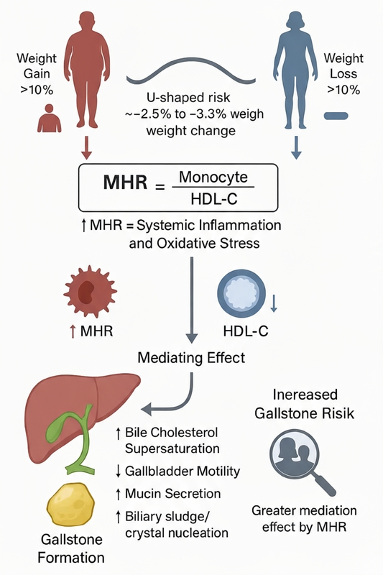

Nonlinear association between weight gain and gallstone risk: the mediating role of the inflammatory marker MHR
DOI: 10.5114/aoms/214619
Arch Med Sci 2025;21(6):2864-2867
Notes:
Introduction
Material and methods
Results
Conclusions

