Slide 1
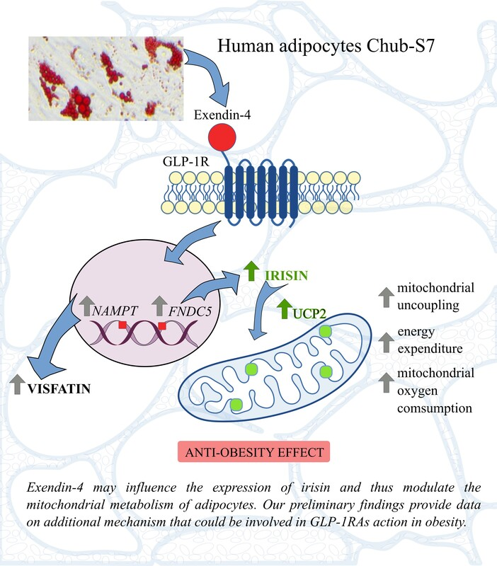

Irisin may be involved in exendin-4 mitochondrial action in human adipocytes
DOI: 10.5114/aoms/214730
Arch Med Sci 2026;22(2):958-967
Notes:
Introduction
Disturbed mitochondrial activity in adipocytes has been proposed as one of the mechanisms involved in metabolic dysfunction in obesity. Glucagon-like peptide receptor agonists (GLP-1RAs) are used to normalize glucose level and reduce body weight. GLP-1 activates intracellular pathways similar to those of irisin, a peptide that modulates metabolism by stimulating the ‘browning’ of adipocytes. The aim of the study was to investigate the mechanisms of action of the GLP-1RA exendin-4 at the mRNA, protein, and mitochondrial levels in human adipocytes.
Material and methods
Human Chub-S7 preadipocytes were differentiated in vitro to mature adipocytes and then stimulated with exendin-4 at 100 nM for 24 h. Expression levels of mRNA and proteins (irisin, adiponectin, visfatin/NAMPT) were measured. Oxygen consumption rates and intracellular ATP content were determined.
Results
Exendin-4 enhanced the secretion of irisin and visfatin by adipocytes. Upregulated expression of FNDC5, NAMPT, and UCP2 genes was accompanied by modest changes in mitochondrial activity in exendin-4-treated adipocytes. Exendin-4 exerted a similar effect on mitochondrial oxygen consumption rates as irisin, including increased maximum mitochondrial respiration and reserve capacity with unchanged intracellular ATP.
Conclusions
Increasing energy expenditure by exendin-4 may be associated with upregulation of irisin in human adipocytes. Clinical studies are necessary to confirm the hypothesis that nutrients, by stimulating the secretion of GLP-1, may influence the expression of irisin and thus modulate the mitochondrial metabolism of adipocytes.

