Slide 1
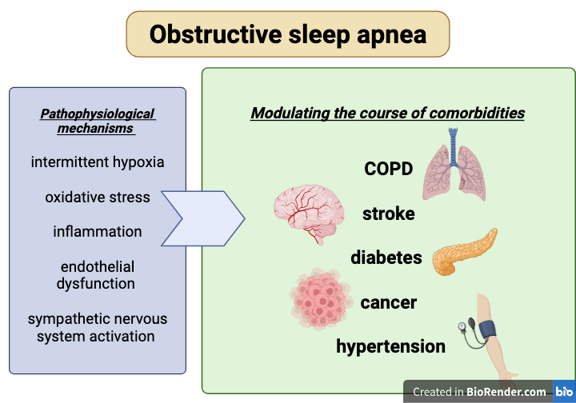

Obstructive sleep apnea and selected comorbidities – a literature review of cohort studies
DOI: 10.5114/aoms/214987
Arch Med Sci 2026;22(4):2277-2285
Notes:
Obstructive sleep apnea (OSA) is the most common type of sleep-related breathing disorder, characterized by repeated episodes of upper airway collapse and resulting hypoxia during sleep. Intermittent hypoxemia may exert a multisystemic impact and modulate the course of comorbidities. Pathophysiological mechanisms such as oxidative stress, inflammation, and endothelial dysfunction contribute to adverse health outcomes including cardiovascular disease, cerebrovascular complications, metabolic disorders, cancer, neurodegenerative conditions, or behavioral abnormalities. Treatment of OSA may mitigate progression of comorbidities and reduce the associated social and economic burden. This literature review aims to explore the relationships between OSA and selected comorbid diseases, including chronic obstructive pulmonary disease (COPD), stroke, diabetes, cancer, and hypertension, based on cohort studies in the literature.

