Slide 1
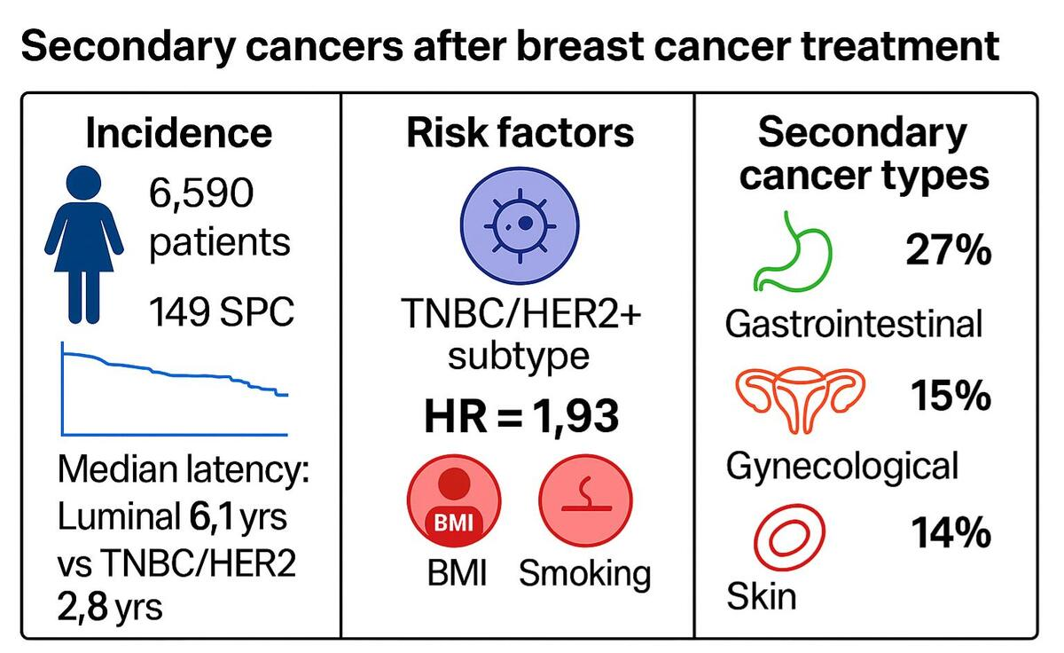

Secondary cancers in breast cancer survivors. A two-centre study
DOI: 10.5114/aoms/215281
Arch Med Sci 2026;22(3):1470-1481
Notes:
Introduction
The risk of secondary cancers in breast cancer survivors remains a significant concern. This study aimed to evaluate the association between treatment modalities and the time to development of secondary cancers in patients after mastectomy or breast-conserving therapy (BCT).
Material and methods
A retrospective analysis was conducted on 6590 patients from 2 centres (Poznan and Gorzow, Poland) treated for breast cancer between 2017 and 2022. A total of 149 patients from this group developed secondary cancer. Data included demographic and clinical characteristics, treatment types (chemotherapy, hormonotherapy, radiotherapy), and subtypes of primary breast cancer (luminal, triple negative, HER2 positive). Statistical methods included Kaplan-Meier analysis, Cox proportional hazards models, and <i>X</i><sup>2</sup> tests.
Results
The median time to secondary cancer detection was significantly shorter in patients with TNBC/HER2+ subtypes (2.8 years) compared to luminal subtypes (6.1 years; p = 0.024). TNBC/HER2+ subtypes were associated with a 1.9-fold increased risk of secondary cancers (HR = 1.93; p = 0.048). No significant association was found between treatment type and the occurrence of secondary cancers (p > 0.05). However, combined therapies (e.g. chemotherapy + hormonotherapy) showed a trend toward reduced risk (HR = 0.53; p = 0.061). The most common secondary cancers were gastrointestinal malignancies (27%) and gynaecological cancers (15%).
Conclusions
The subtype of primary breast cancer significantly influences the time to secondary cancer development, with TNBC/HER2+ patients at higher risk. Treatment modalities did not significantly affect secondary cancer risk, but combined therapies may offer protective effects. These findings highlight the need for tailored surveillance strategies based on tumour biology.

