Slide 1
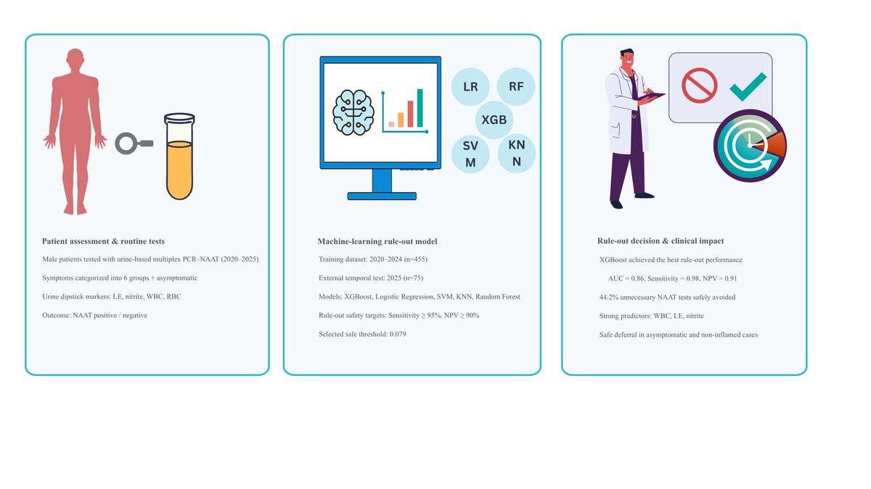

Comparing machine learning models for rule-out prediction of sexually transmitted infections in male patients: a retrospective study using urinalysis and symptom data
DOI: 10.5114/aoms/215558
Notes:
Introduction
Sexually transmitted infections (STIs) are a major public health issue, and prompt diagnosis is crucial for controlling infections. Multiplex PCR-based nucleic acid amplification tests (NAATs) are the gold standard for diagnosis, especially for identifying pathogens involved in gonococcal and nongonococcal urethritis. However, their frequent use in low-risk or asymptomatic men increases laboratory workload and healthcare expenses.
Material and methods
This study employed machine learning algorithms to develop and validate a rule-out model designed to reduce unnecessary NAAT requests. Data from 2020 to 2024 (n = 455) were used for model training, and data from 2025 (n = 75) served as an external temporal test set. Model thresholds were optimized to ensure high sensitivity (≥ 95%) and a high negative predictive value (NPV ≥ 90%), emphasizing patient safety and reducing the risk of false negatives. The selected rule-out threshold (0.079) represented the lowest predicted-probability cut-point achieving these safety criteria and was applied to the independent test cohort. Data were collected from our institutional database. Five supervised models – XGBoost, logistic regression (LR), support vector machine (SVM), k-nearest neighbors (KNN), and random forest – were built and assessed.
Results
XGBoost achieved the best rule-out performance (AUC = 0.86; sensitivity = 0.98; NPV = 0.91) while safely deferring NAAT testing in 44.2% of patients. Urinary WBC, leukocyte esterase, and nitrite were the strongest positive predictors, whereas absence of inflammation and asymptomatic presentation favored test deferral.
Conclusions
This model can assist clinicians in identifying male patients likely to test negative on NAATs, supporting diagnostic stewardship through cost-effective, data-driven decision-making.

