Slide 1
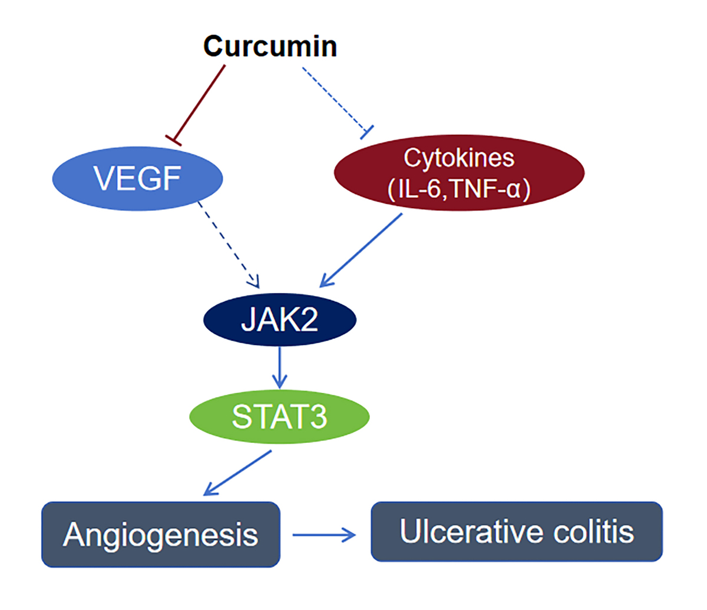

Curcumin ameliorates ulcerative colitis via inhibiting STAT3-mediated angiogenesis
DOI: 10.5114/aoms/215559
Arch Med Sci 2026;22(2):926-939
Notes:
Introduction
Ulcerative colitis (UC) is a chronic and persistent inflammatory bowel disease with limited clinical treatment options and significant therapeutic challenges. This study aimed to evaluate whether the therapeutic effect of curcumin against ulcerative colitis is positively correlated with its inhibition of angiogenesis and to elucidate the underlying angiogenesis-related molecular mechanism.
Material and methods
A multi-database analysis was performed to predict the possible targets involved in curcumin inhibition of UC. Tube formation and aortic ring assays were used to evaluate angiogenesis in vitro. A dextran sulfate sodium (DSS)-induced ulcerative colitis mouse model was used to evaluate curcumin’s effect on UC.
Results
We first employed a comprehensive multi-database analysis to identify overlapping targets connecting curcumin, ulcerative colitis, and angiogenesis, leading to the identification of signal transducer and activator of transcription 3 (STAT3) as a potential mediator of this process. In vitro experimental results demonstrated that curcumin significantly inhibited tube formation in human umbilical vein endothelial cells (HUVEC) and suppressed endothelial sprouting in rat aortic rings. Furthermore, curcumin downregulated the expression of vascular endothelial growth factor (VEGF) in HUVEC cells and concurrently inhibited the expression of phosphorylated JAK2 and phosphorylated STAT3 (Y705). Notably, the addition of VEGF partially reversed curcumin’s inhibitory effects on p-JAK2 and p-STAT3. In vivo studies using a DSS-induced mouse model of ulcerative colitis revealed that curcumin ameliorated DSS-induced colon shortening and various disease symptoms. It also suppressed serum levels of TNF- and IL-6 and inhibited the expression of STAT3 and VEGF in colonic tissues.
Conclusions
Curcumin ameliorates ulcerative colitis through inhibition of the VEGF-mediated JAK2/STAT3 signaling pathway. These findings position curcumin as a potential clinical candidate drug for the treatment of ulcerative colitis.

