Slide 1
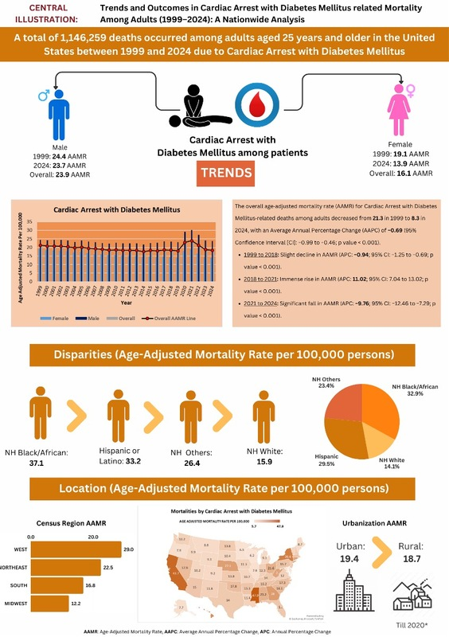

Mortality trends related to cardiac arrest in patients with diabetes mellitus aged 25 and older across the United States: an analysis using the CDC WONDER database from 1999 to 2024
DOI: 10.5114/aoms/215585
Arch Med Sci 2026;22(1):75-86
Notes:
Introduction
Cardiac arrest (CA) is a leading cause of death in the US, with over 600,000 cases annually. People with diabetes mellitus (DM) have higher CA risk and worse outcomes due to factors such as obesity, hypertension, and dyslipidemia. This study examined the mortality trends of CA among adults with diabetes from 1999 to 2024.
Material and methods
We analyzed data from the CDC WONDER multiple-cause-of-death database, identifying decedents aged ≥ 25 years with both CA and DM listed as underlying or contributing causes of death (ICD-10: I46.0 to I46.9 for CA; E10-E14 for DM). Annual crude and age-adjusted mortality rates were calculated. Joinpoint regression was used to identify trend changes and calculate annual percent changes (APC) and average annual percent changes (AAPC).
Results
Between 1999 and 2024, a total of 1,146,259 deaths were recorded. Overall, the age-adjusted mortality rate (AAMR) decreased from 21.3 per 100,000 in 1999 to 18.3 in 2024 with an AAPC of -0.69. However, a significant increase occurred from 2018 to 2021 (APC: +11.02), coinciding with the COVID-19 pandemic. Men exhibited higher AAMRs than women (23.9 and 16.1, respectively), and non-Hispanic Black individuals had the highest racial AAMRs at 37.1. Geographic disparities revealed the Western U.S. to have the highest mortality rate at 29, and urban areas to have slightly higher AAMRs than rural areas (19.4 vs. 18.7).
Conclusions
While CA-related mortality among diabetic adults decreased from 1999 to 2018, a rise between 2018 and 2021 highlights vulnerabilities, especially among men, non-Hispanic Black populations, and high-burden regions. Continued efforts are necessary to address healthcare disparities and enhance emergency responses, thereby reducing mortality gaps.

