Slide 1
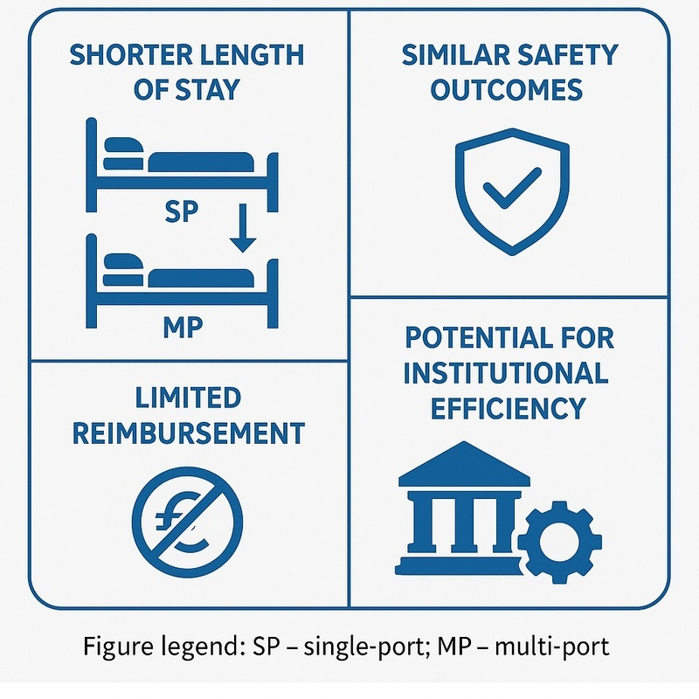

Single-port robotic urology in Central Europe after regulatory approval: efficiency and reimbursement
DOI: 10.5114/aoms/215792
Arch Med Sci 2025;21(6):2891-2894

