Slide 1
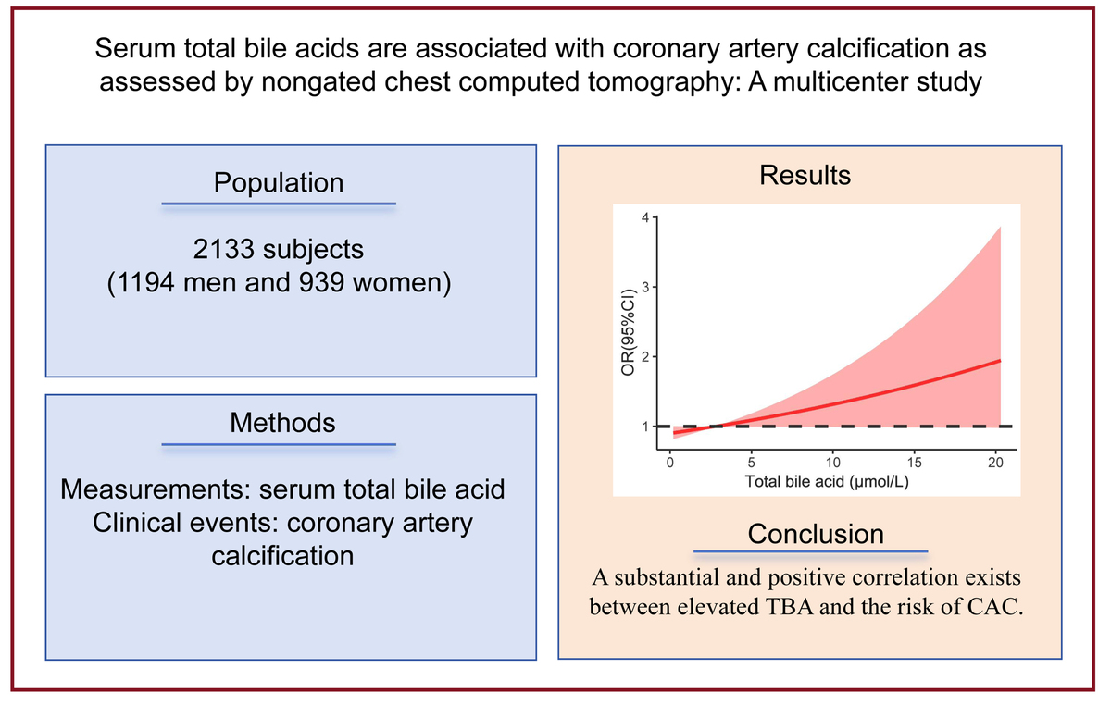

Serum total bile acids are associated with coronary artery calcification as assessed by non‑gated chest computed tomography: a multicenter study
DOI: 10.5114/aoms/216044
Arch Med Sci 2026;22(3):1381-1388
Notes:
Introduction
Coronary artery calcification (CAC) is a risk factor for cardiovascular disease (CVD). The association between serum total bile acid (TBA) concentration and CAC has not been investigated, even though bile acid may act as a mediator between gut microbiota and CVD. We examined this relationship in a general Chinese population.
Material and methods
This cross-sectional study included 2133 people who underwent computed tomography (CT) scans for lung cancer screening between 2018 and 2020. Information on medical history, laboratory test results, and demographics was collected from medical records. CAC was assessed on non-gated chest CT images. Multivariable logistic regression analysis and restricted triple spline analysis were applied to examine the correlation between TBA and CAC risk.
Results
CACs were detected in 426 of 2133 participants. Participants with higher TBA concentrations had a considerably higher prevalence of CAC (33.4% in the fourth quartile and 11.5% in the first quartile, p < 0.001). TBA was closely associated with CAC, as determined by multivariable logistic regression analysis (OR = 1.05, 95% CI: 1.00–1.10). The fourth TBA quartile was significantly associated with a high incidence of CAC in the general population (OR = 1.76, 95% CI: 1.02–3.06), in older adults (OR = 1.66, 95% CI: 1.03–2.68), and in subjects without diabetes (OR = 1.62, 95% CI: 1.07–2.45) or hypertension (OR = 1.74, 95% CI: 1.16–2.63) when compared to the first TBA quartile.
Conclusions
A substantial and positive correlation was found between elevated TBA and CAC. The causal relationship between TBA and CAC risk should be investigated in longitudinal studies.

