Slide 1
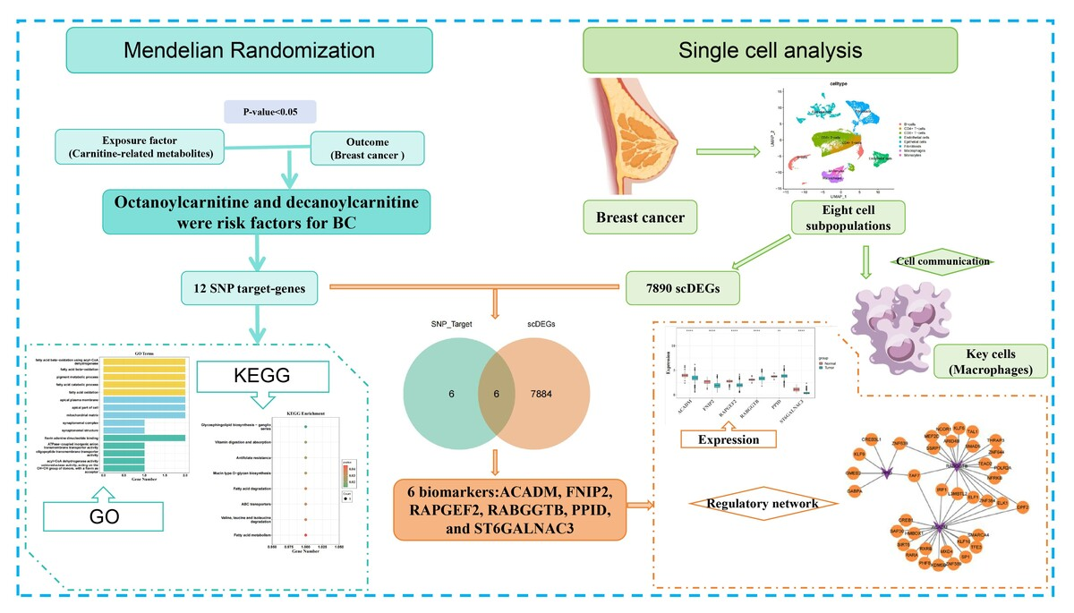

Evaluating the potential causal relationship between carnitine-related metabolites and breast cancer: a Mendelian randomization and transcriptomic analysis
DOI: 10.5114/aoms/216186
Arch Med Sci 2026;22(3):1688-1705
Notes:
Introduction
Breast cancer (BC) is the most common malignancy among women worldwide. Although observational studies have linked carnitine-related metabolites (CRMs) to BC, causal inference has been limited by confounding and reverse causality. This study used Mendelian randomization (MR) analysis to investigate the potential causal link between CRMs and BC.
Material and methods
MR analysis was conducted using the Cancer Genome Atlas-BC and CRM-related datasets to explore the potential causal relationship between CRMs and BC. Variants were screened based on criteria encompassing genome-wide significance (p < 5×10–8), independence (r² < 0.001, kb=10000), and sufficient strength (F-statistic > 10). Various MR techniques, including inverse-variance weighted, MR-Egger, simple mode, weighted mode, and weighted median approaches, were applied to assess these potential causal associations. Single-cell RNA sequencing (scRNA-seq) was employed to investigate the expression and biological functions of biomarkers linked to metabolites.
Results
The MR analysis suggested that genetically predicted elevated levels of octanoylcarnitine and decanoylcarnitine were associated with increased risk of BC. Functional enrichment analysis identified 12 candidate genes associated with these metabolites, which are involved in fatty acid -oxidation (FAO) pathways. ScRNA-seq analysis revealed eight distinct cell subpopulations, with macrophages exhibiting the highest intercellular communication. Six biomarkers were identified as potential contributors to BC development: ACADM, FNIP2, RAPGEF2, RABGGTB, PPID, and ST6GALNAC3.
Conclusions
This study provides evidence supporting potential causal associations between octanoylcarnitine and decanoylcarnitine and BC risk. Integrative single-cell transcriptomics revealed six CRM-associated biomarkers and their dynamic expression within tumor microenvironments. Additional experimental and clinical studies are needed to validate these observations and clarify their biological and translational relevance.

