Slide 1
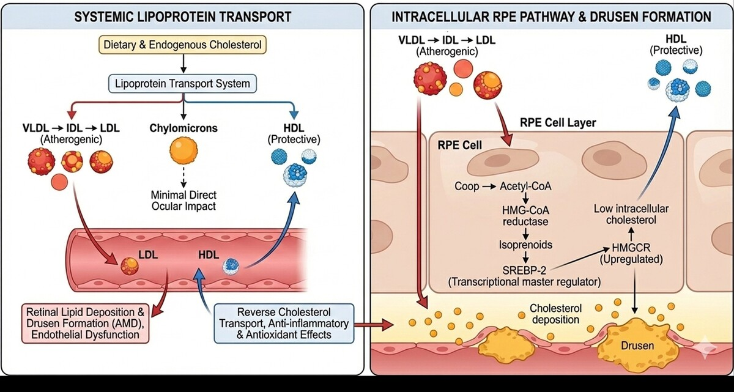

Understanding the link between lipid and ocular disorders for effective therapy
DOI: 10.5114/aoms/216374
Arch Med Sci 2026;22(2):583-601
Notes:
Cholesterol is an essential lipid for cellular integrity and metabolic homeostasis; however, dysregulated cholesterol metabolism is increasingly recognized as a key contributor to multiple ocular diseases. Beyond its established role in cardiovascular pathology, emerging evidence implicates altered lipoprotein balance, impaired cholesterol transport, and lipid-driven inflammation in the pathogenesis of age-related macular degeneration, retinal vascular diseases, cataracts, and glaucoma. This review integrates current knowledge on cholesterol synthesis, transport, and regulation with ocular-specific mechanisms, emphasizing the differential roles of low-density lipoprotein, high-density lipoprotein, and triglyceride-rich lipoproteins. Key molecular pathways, including the mevalonate-SREBP axis, ABCA1/ABCG1-mediated reverse cholesterol transport, VEGF-driven angiogenesis, oxidative stress signaling, and inflammatory cascades, are critically discussed. Clinical and translational implications are highlighted, particularly the potential ocular benefits of lipid-modulating therapies such as statins, fenofibrate, and antioxidant supplementation. Understanding cholesterol as a modifiable determinant of ocular health may enable integrated preventive strategies and guide future therapeutic innovation in vision-threatening diseases.

