Slide 1
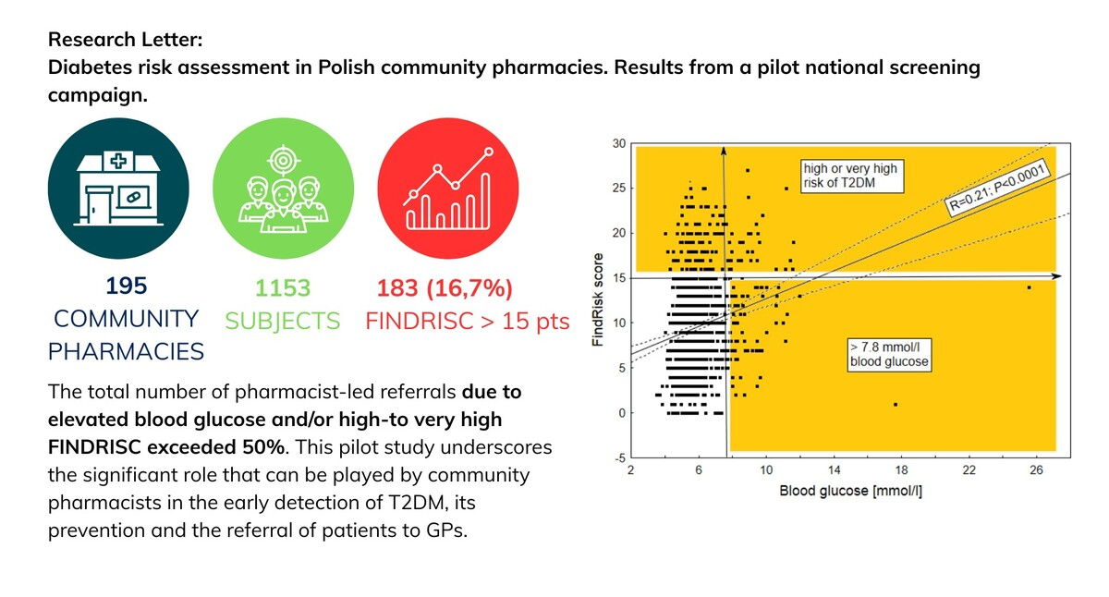

Diabetes risk assessment in Polish community pharmacies. Results from a pilot national screening campaign
DOI: 10.5114/aoms/216396
Arch Med Sci 2026;22(1):527-530
Notes:
Introduction
Material and methods
Results
Conclusions

