Slide 1
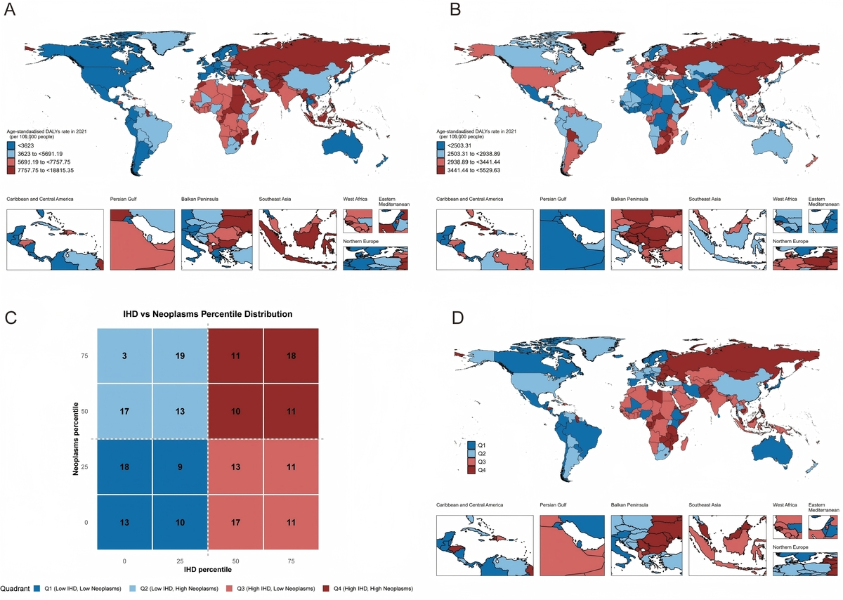

Global co-occurrence patterns of cancer and cardiovascular disease: a comprehensive analysis based on the Global Burden of Disease Study 2021
DOI: 10.5114/aoms/216397
Arch Med Sci 2026;22(2):760-781
Notes:
Introduction
Cardiovascular disease (CVD) and neoplasms are the two leading causes of death worldwide. Previous research has predominantly addressed these conditions separately or focused on specific regions. We aimed to characterize the global co-occurrence pattern of CVD and neoplasms from spatial and temporal perspectives and identify corresponding risk factors across different epidemiological contexts.
Material and methods
Using GBD 2021 data, we extracted age-standardized disability-adjusted life year (DALY) rates of CVD and neoplasms and modifiable risk factor exposure from 204 countries and territories (1990–2021). We identified four epidemiological patterns: low- burden, neoplasm-dominant, CVD-dominant, and dual-burden regions. We calculated population attributable fractions (PAF) and integrated machine learning with SHAP values to distinguish intervention priorities. Average annual percentage changes (AAPC) were used to evaluate temporal trends.
Results
Each pattern comprised 50–52 countries. Spatial distribution overlapped with socioeconomic development stages and risk factor exposure. Temporal analysis revealed widening global inequality: low-burden regions achieved 3–4% annual reductions while dual-burden regions experienced an increasing burden, creating a 5.8 percentage point gap. High systolic blood pressure was the universal dominant CVD risk factor, accounting for 49.7% of the global burden (49.2–52.4% across patterns). For neoplasms, smoking contributed 18.5% globally but varied dramatically by pattern (10.4–23.4%). Modifiable risk factors’ specific combinations greatly influenced global disparities.
Conclusions
The co-occurrence of CVD and neoplasms represents interconnected manifestations of different epidemiological transition stages, with concerning divergence between regions. Interventions targeting hypertension control and tobacco cessation, combined with pattern-specific strategies, can fundamentally reduce the global disease burden.

