Slide 1
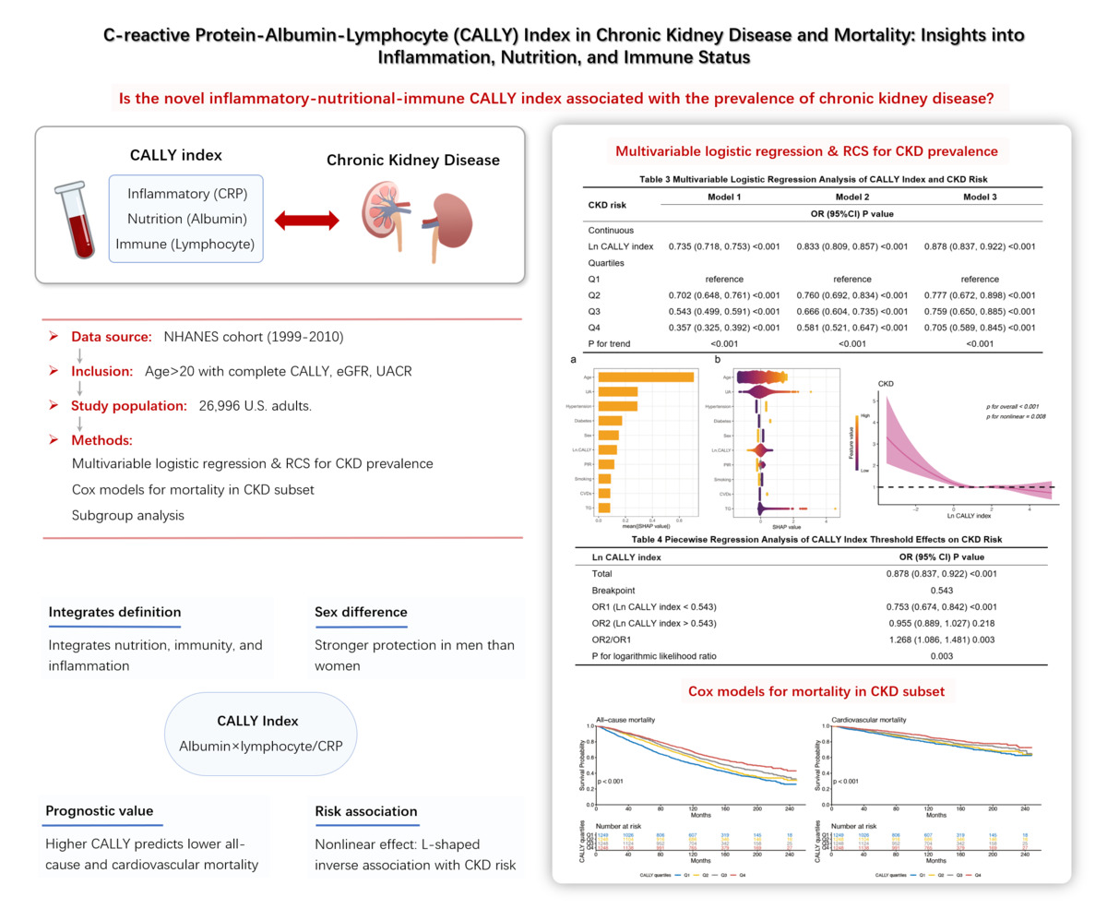

C-reactive protein-albumin-lymphocyte (CALLY) index in chronic kidney disease and mortality: insights into inflammation, nutrition, and immune status
DOI: 10.5114/aoms/216398
Arch Med Sci 2026;22(3):1389-1398
Notes:
Introduction
The C-reactive protein-albumin-lymphocyte (CALLY) index represents a novel composite biomarker integrating inflammatory, nutritional, and immune parameters. We aimed to examine the relationship between CALLY index and chronic kidney disease (CKD) prevalence.
Material and methods
This cross-sectional analysis utilized data from the National Health and Nutrition Examination Survey. CKD was defined as an estimated glomerular filtration rate (eGFR) < 60 ml/min/1.73 m² and/or urinary albumin-to-creatinine ratio (UACR) ≥ 30 mg/g. Multivariable logistic regression and restricted cubic spline (RCS) analyses assessed the relationship between CALLY index and CKD risk. Among CKD patients, Cox proportional hazards models evaluated associations of the CALLY index with all-cause and cardiovascular mortality.
Results
Among the 26 996 participants, 4997 individuals were diagnosed with CKD. Participants with CKD demonstrated lower CALLY index values compared to those without CKD. Multivariable logistic regression indicated that, compared to the lowest quartile, the highest quartile showed 29.5% reduced CKD risk (OR = 0.705, 95% CI: 0.589–0.845, p < 0.001). The RCS model demonstrated a significant L-shaped association between CALLY index and CKD prevalence. Among CKD patients, higher CALLY index significantly predicted better survival outcomes for both all-cause and cardiovascular mortality.
Conclusions
The CALLY index demonstrates inverse associations with CKD risk and mortality, suggesting its potential utility as a comprehensive biomarker for CKD risk stratification and prognosis assessment.

