Slide 1
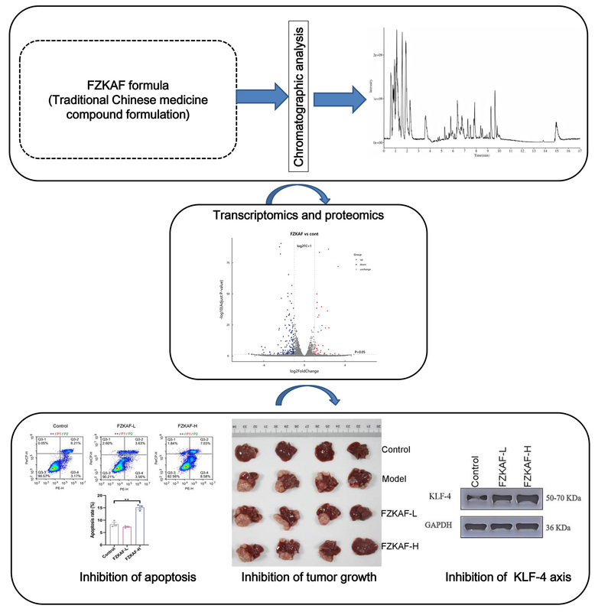

Fuzheng Kang’ai decoction suppresses hepatocellular carcinoma via regulation of the KLF4/HIF-1α/CA9 signaling axis
DOI: 10.5114/aoms/216399
Notes:
Introduction
Clinical studies have established the efficacy of Fuzheng Kang’ai formula (FZKAF) in hepatocellular carcinoma (HCC) management. The molecular basis of FZKAF’s HCC-suppressive effects is not fully characterized. This investigation aimed to mechanistically delineate FZKAF’s therapeutic actions against HCC.
Material and methods
Phytochemical characterization via liquid chromatography-mass spectrometry (LC-MS) established the decoction’s bioactive constituents. CCK-8 assays quantified proliferative suppression and cytotoxicity, while Annexin V-FITC/PI staining and cell cycle analysis mapped apoptosis induction. Integrated proteomic and transcriptomic profiling screened core targets and signaling pathways. Therapeutic efficacy was ultimately confirmed in an orthotopic HCC nude mouse model.
Results
Phytochemical profiling identified 33 bioactive compounds in serum following FZKAF administration, including 9 established anti-tumor agents such as paeoniflorin, catechin, kaempferol, and quercetin. Functionally, FZKAF demonstrated dual anti-HCC efficacy by suppressing tumor growth in vivo and inhibiting 97H cell proliferation in vitro while promoting apoptosis through mitochondrial dysfunction. Mechanistic interrogation via multi-omics revealed FZKAF coordinately modulates KLF4, HIF-1a, and CA9 targets to disrupt oncogenic signaling.
Conclusions
FZKAF orchestrates apoptosis induction and growth suppression in HCC, at least partially, by modulating the KLF4/HIF-1a/CA9 signaling axis, revealing a novel druggable pathway that advances precision oncology strategies for HCC patients.

