Slide 1
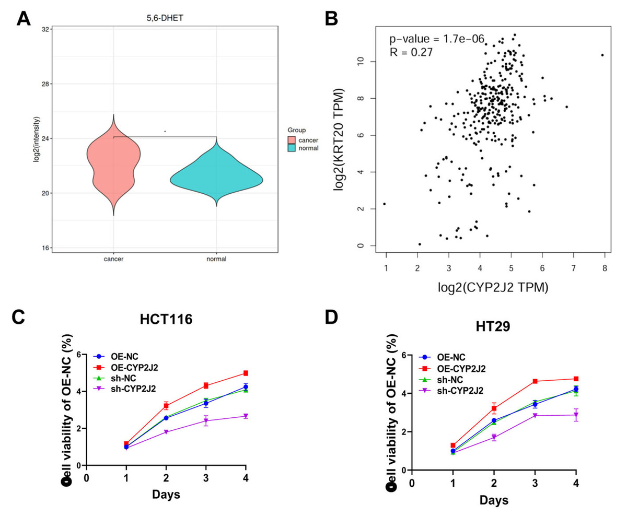

CYP2J2 links metabolic reprogramming to colorectal cancer progression
DOI: 10.5114/aoms/216416
Arch Med Sci 2025;21(6):2872-2875
Notes:
Introduction
Material and methods
Results
Conclusions

