Slide 1
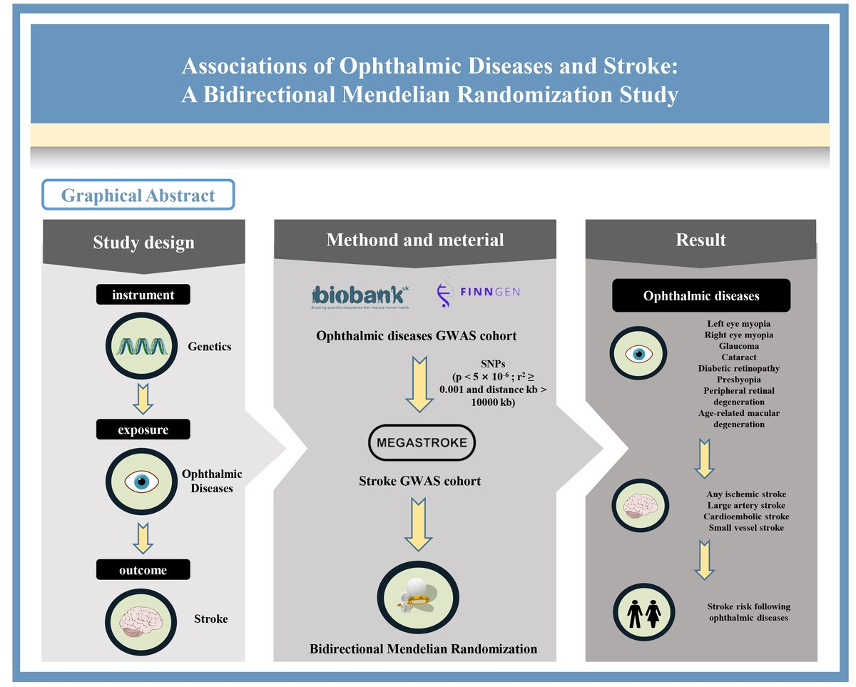

Association of ophthalmic diseases with stroke: cohort study and Mendelian randomization analysis
DOI: 10.5114/aoms/216656
Arch Med Sci 2026;22(1):540-550
Notes:
Introduction
Material and methods
Results
Conclusions

