Slide 1
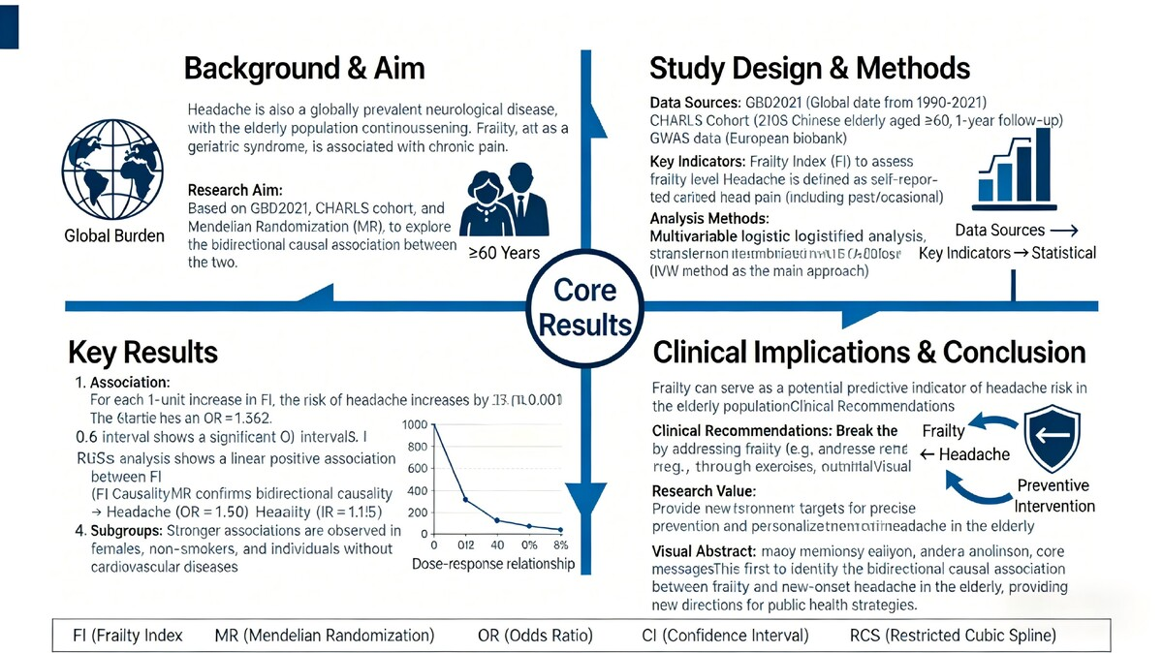

The association between frailty and headache in middle-aged and older individuals: a data analysis based on the GBD2021, the CHARLS and Mendelian randomization
DOI: 10.5114/aoms/216957
Arch Med Sci 2026;22(3):1433-1456
Notes:
Introduction
Headache is a common neurological disease with a significant impact on individuals and a high social economic burden.
Material and methods
We explored the association between frailty (assessed by FI) and incidence of new headaches among older individuals using the Global Burden of Disease database and the China Health and Retirement Longitudinal Study (CHARLS).
Results
We examined 2108 individuals aged 60 years and older, and found that 16.56% of them reported incidence headache. The results demonstrated a clear association between higher levels of frailty and higher risks of headaches. Higher FI was associated with 1% higher odds of having headaches (OR = 1.12, p < 0.001, 1 unit increase of FI). Individuals in highest quartile of FI had OR = 1.36 compared to the lowest quartiles of FI. Results of multi-variable logistic regression analysis consistently supported our findings in different adjusted models. Subgroup analyses showed similar results in different subgroups. Moreover, Mendelian Ran-domization analysis also supported the genetic correlation between frailty and headache phenotype (OR for FI and headache: 3.023 and 2.937, p < 0.001).
Conclusions
The growing global burden of headaches, especially in older adults, underscores the urgency of targeted interventions. Our findings imply that frailty may be a potential indicator of headache risk, and they call for healthcare strategies to reduce the incidence of headache by intervening in frailty. In the future, we will focus on the biological processes underlying the frailty-headache association to provide credible targets for personalized treatment and evidence-based preventive care.

