Slide 1
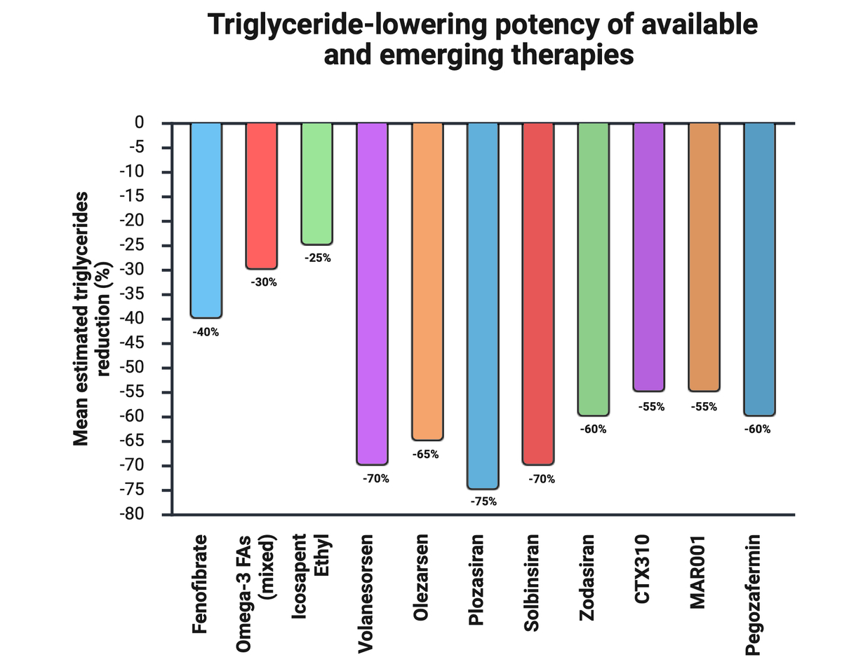

2025: The year in cardiovascular disease – the year of triglyceride lowering therapies. Can we effectively reduce triglyceride-related residual cardiovascular disease and pancreatitis risk?
DOI: 10.5114/aoms/216960
Arch Med Sci 2025;21(6):2229-2245
Notes:
This state-of-the-art review surveys the rapidly advancing field of triglyceride-lowering therapies as of 2025, positioning hypertriglyceridemia (HTG) as both a residual driver of atherosclerotic cardiovascular disease (ASCVD) and a key precipitant of acute pancreatitis. After outlining the pathophysiological role of elevated triglycerides – via remnant lipoproteins, inflammation and endothelial dysfunction, often within the lipid triad of low high-density lipoprotein-cholesterol (HDL-C) and small, dense low-density lipoprotein (LDL) – we evaluate established and emerging pharmacologic options. Fenofibrate, a PPAR- activator, remains a cornerstone for mixed dyslipidemia, improving micro- and macrovascular outcomes in diabetes. Purified eicosapentaenoic acid (icosapent ethyl) is highlighted for its robust reduction of major adverse cardiovascular events despite neutral triglyceride thresholds, albeit with a modest increase in atrial fibrillation risk. Novel agents targeting apolipoprotein C-III (volanesorsen, olezarsen, plozasiran) achieve profound triglyceride declines and substantially mitigate pancreatitis in familial chylomicronemia syndrome (FCS), while angiopoietin-like 3 (ANGPTL3) inhibitors and fibroblast growth factor 21 (FGF21) agonists demonstrate early promise in broad atherogenic-lipid reduction and metabolic modulation. The paper emphasizes the importance of genetic testing to differentiate FCS from multifactorial chylomicronemia syndrome, guiding personalized therapy. Current guidelines endorse icosapent ethyl and fenofibrate for high-risk HTG, with apoC-III inhibitors poised to become first-line for FCS as access improves. Ongoing trials of ANGPTL3 inhibitors, FGF21 agonists and gene-editing approaches may soon redefine lifelong lipid management.

