Slide 1
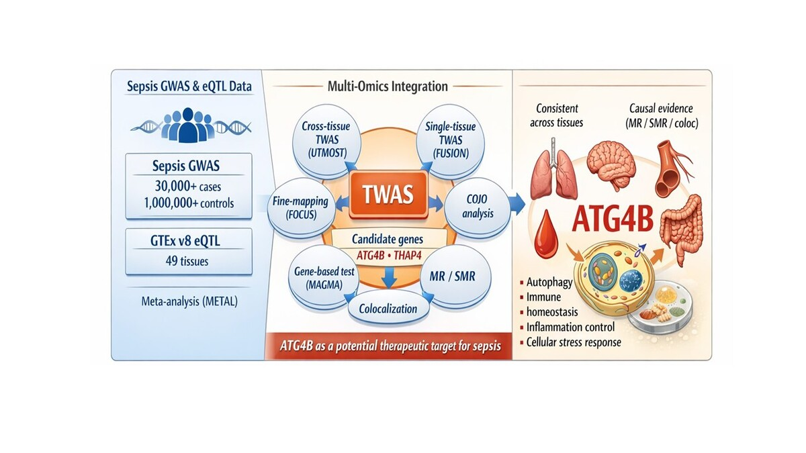

From GWAS to TWAS: multi-omics dissection of sepsis uncovers consistent impact of <i>ATG4B</i> across tissues
DOI: 10.5114/aoms/217046
Arch Med Sci 2026;22(1):572-578
Notes:
Introduction
Material and methods
Results
Conclusions

