Slide 1
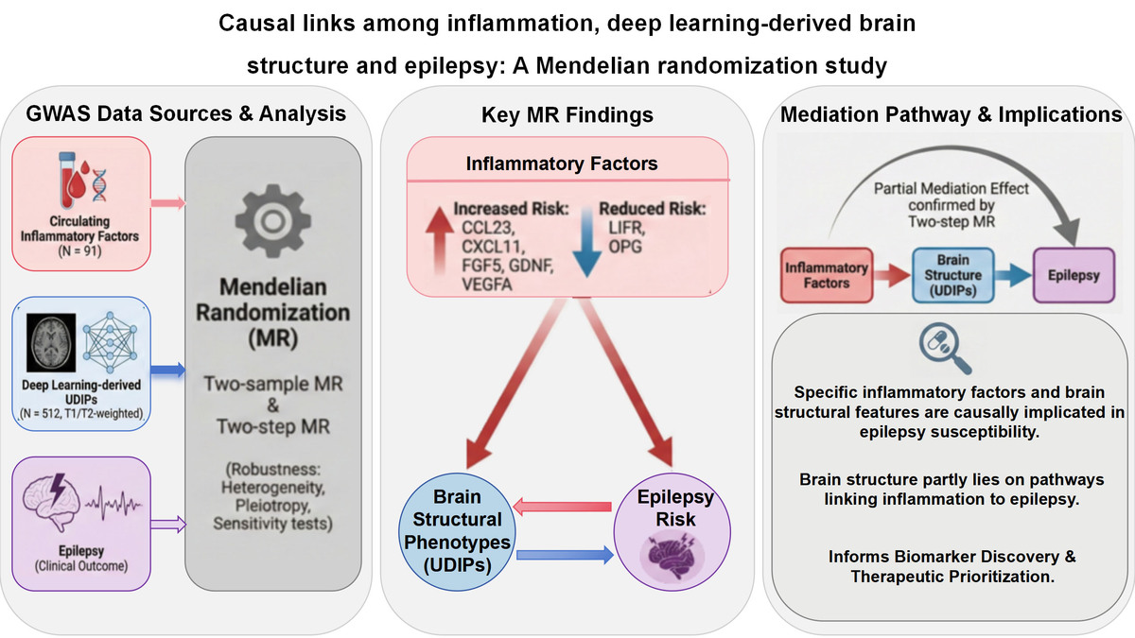

Deciphering the interplay between inflammatory factors and brain structural features in epilepsy
DOI: 10.5114/aoms/217232
Notes:
Introduction
The aim of the study was to evaluate potential causal links among circulating inflammatory factors, deep learning–derived brain structural phenotypes (unimodal deep imaging phenotypes – UDIPs), and epilepsy using Mendelian randomization (MR).
Material and methods
We used genome-wide association study (GWAS) summary statistics for 512 UDIPs derived from whole-brain MRI, 91 circulating inflammatory factors, and epilepsy. Two-sample MR was used to systematically estimate: (i) the effects of inflammatory factors on epilepsy, (ii) the effects of inflammatory factors on UDIPs, and (iii) the effects of UDIPs on epilepsy. We further applied two-step MR to explore whether UDIPs may mediate the associations between inflammatory factors and epilepsy. Robustness was assessed using heterogeneity tests, pleiotropy evaluation, and sensitivity analyses.
Results
Several inflammatory factors showed significant associations with epilepsy risk. Genetically predicted higher levels of CCL23, CXCL11, FGF5, GDNF, and VEGFA were associated with increased epilepsy risk, whereas higher levels of LIFR and OPG were associated with reduced risk. MR analyses also identified multiple T1- and T2-weighted UDIP dimensions associated with epilepsy in opposite directions, indicating heterogeneous structural signatures linked to epilepsy liability (e.g., T1 dimension 76 showed a positive association, while other dimensions were inversely associated). Two-step MR suggested that, for selected pathways, UDIPs may partly explain the associations between inflammatory factors and epilepsy, consistent with partial mediation. These findings were broadly consistent across heterogeneity, pleiotropy, and sensitivity analyses.
Conclusions
These findings implicate specific inflammatory factors and MRI-derived structural phenotypes in epilepsy susceptibility and suggest that brain structural features may partly lie on pathways linking inflammation to epilepsy, providing potential insights for biomarker discovery and therapeutic prioritization.

