Slide 1
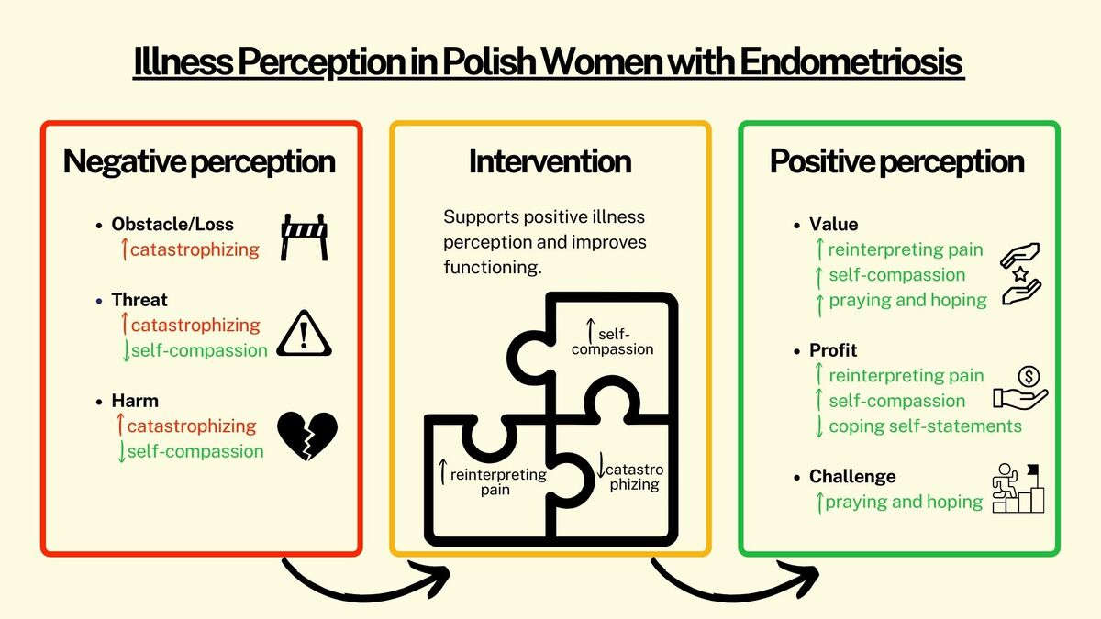

Illness perception, pain coping, and self-compassion: a cross-sectional study of Polish women with endometriosis
DOI: 10.5114/aoms/217516
Notes:
Introduction
Endometriosis is a chronic inflammatory gynecological disease, one of whose main symptoms is chronic pain. Generally, negative perceptions of the disease as an obstacle/loss, harm, or threat are linked to poorer adjustment, whereas positive perceptions of illness as a challenge, value, or profit show the opposite pattern. The study aimed to investigate whether pain-coping strategies and self-compassion in women with endometriosis were associated with the perception of their disease in terms of obstacle/loss, threat, harm, value, challenge, and profit.
Material and methods
The study group consisted of 265 Polish women with a diagnosis of endometriosis. The online survey included three measures: the Self-Compassion Scale (SCS-PL), the Coping Strategies Questionnaire (CSQ), and the Disease-Related Appraisals Scale (DRAS).
Results
Perceiving illness in negative terms – as an obstacle/loss, threat, or harm – was associated with catastrophizing about pain. Threat and harm categories were also inversely related to self-compassion. Perceptions of endometriosis in terms of value or profit were positively associated with the strategy of reinterpreting pain sensations and by self-compassion. The profit category was also negatively associated with coping self-statements, whereas viewing illness as value or challenge was associated with the praying and hoping strategy.
Conclusions
Higher self-compassion and greater use of reinterpreting pain sensations were associated with more positive perceptions of endometriosis, whereas catastrophizing was associated with more negative perceptions. These findings may help inform psychological interventions supporting women with endometriosis, although longitudinal or intervention studies are needed to determine whether modifying these factors changes illness perceptions and improves functioning or quality of life.

