Slide 1
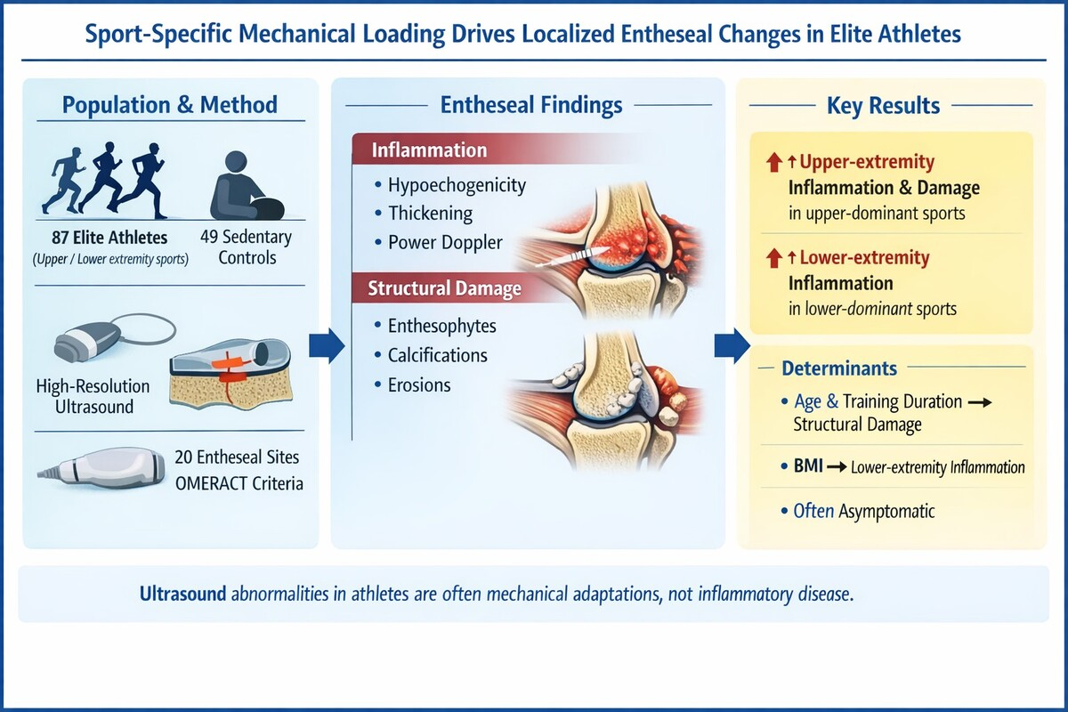

Sport-related entheseal adaptation and damage
in elite athletes: a cross-sectional ultrasound study
DOI: 10.5114/aoms/217517
Arch Med Sci 2026;22(4):2154-2162
Notes:
Introduction
Entheses, the sites where tendons, ligaments, and joint capsules insert into bone, are highly susceptible to mechanical stress. While enthesitis is a cardinal feature of spondyloarthritis (SpA), repetitive mechanical loading in elite athletes can also induce entheseal changes. High-resolution ultrasound (US) allows for detailed assessment of entheseal inflammation and structural damage. However, the specific impact of sport-specific loading patterns on differentiating physiological entheseal adaptation from early pathology in asymptomatic elite athletes remains a critical area for investigation.
Material and methods
This cross-sectional study evaluated 87 elite athletes from various sports (athletics, basketball, cycling, golf, handball, climbing, ar-chery) and 49 sedentary controls. Elite status was defined as training > 10 h/week for over 5 years. All participants underwent US evaluation of 20 bilateral entheseal sites. US findings were scored semi-quantitatively (0–3) for inflammation (hypoechogenicity, thickening, power Doppler [PD] signals) and damage (calcifications, erosions, enthesophytes) according to OMERACT definitions. Athletes were grouped by dominant extremity use (upper, lower, or both). Statistical comparisons and linear regression analyses were performed to identify associations between entheseal scores and demographic/training variables.
Results
Elite athletes exhibited significantly higher entheseal inflammation and damage scores compared to sedentary controls (p < 0.05). Athletes practicing upper extremity-dominant sports (e.g., archery, climbing) showed significantly higher upper extremity inflam-mation (median [IQR], 1 [0–3] vs. 0 [0–1.5]; p = 0.010) and damage scores (median [IQR], 0 [0–3] vs. 0 [0–0]; p < 0.001) than con-trols. Similarly, lower extremity-dominant athletes (e.g., athletics, cycling) had significantly higher lower extremity inflammation scores (median [IQR], 2 [1–4] vs. 0 [0–1]; p < 0.001). Linear regression revealed that upper extremity inflammation was inde-pendently associated with age and weekly training duration, while lower extremity inflammation was solely associated with body mass index (BMI). Notably, a high prevalence of US abnormalities was observed despite many athletes being asymptomatic.
Conclusions
Sport-specific mechanical loading is strongly associated with localized entheseal changes detectable by US in elite athletes. These findings underscore the importance of contextualizing US results within an athlete’s specific sport and loading history to distinguish between subclinical entheseal adaptation and true pathology.

