Slide 1
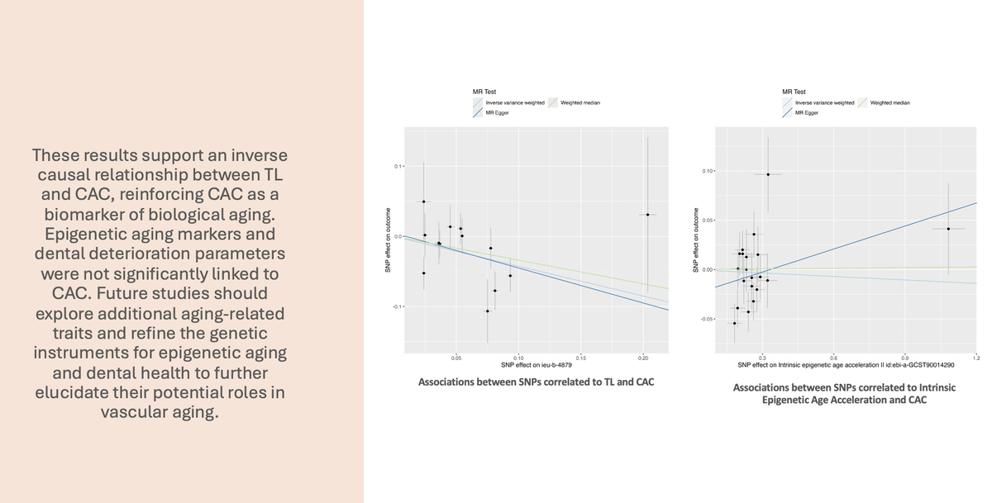

Aging and coronary artery calcification: a Mendelian randomization study
DOI: 10.5114/aoms/217629
Arch Med Sci 2026;22(1):345-354
Notes:
Introduction
Coronary artery calcification (CAC) is a recognized marker of atherosclerosis and cardiovascular disease (CVD) risk. While CAC is closely linked to aging, its potential as a marker of biological aging remains uncertain. Telomere length (TL), epigenetic aging markers, and dental deterioration parameters have been proposed as indicators of biological aging. However, the extent to which these biological aging indicators are associated with CAC remains unclear.
Material and methods
Two-sample and three-sample Mendelian randomization (MR) analyses were conducted to investigate the potential causal effects of TL, epigenetic aging markers (intrinsic epigenetic age acceleration [IEAA], phenotypic age [PhenoAge]), and dental deterioration traits on CAC. Summary-level statistics from large-scale genome-wide association studies (GWASs) were obtained and analyzed using appropriate MR methods.
Results
Genetically determined longer TL was significantly associated with lower CAC levels (IVW p < 0.001), supporting TL as a protective factor against atherosclerosis progression (as measured by CAC). Other analyses confirmed the robustness of this finding (MR-Egger p = 0.03, WME p = 0.004). A three-sample MR analysis provided further evidence for this association (IVW p < 0.01). However, neither epigenetic aging markers nor dental deterioration parameters exhibited a significant causal relationship with CAC.
Conclusions
This study supports an inverse causal relationship between TL and CAC, reinforcing CAC as a biomarker of biological aging. Epigenetic aging markers and dental deterioration parameters were not significantly linked to CAC. Future studies should explore additional aging-related traits and refine the genetic instruments for epigenetic aging and dental health to further elucidate their potential roles in vascular aging.

