Slide 1
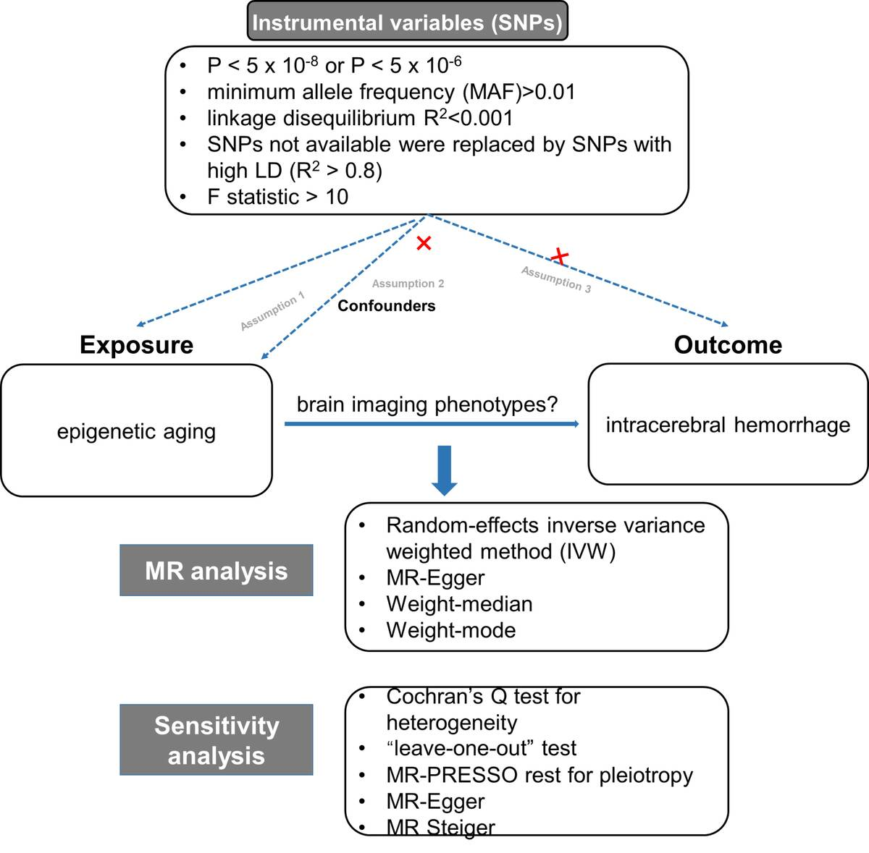

The causal effect of epigenetic aging on intracerebral hemorrhage is not mediated by frontal network function: A Mendelian randomization study
DOI: 10.5114/aoms/217798
Notes:
Introduction
The association between epigenetic clocks and intracerebral hemorrhage (ICH) remains poorly understood. This study investigated whether specific brain imaging phenotypes play a mediating role in the causal pathway from epigenetic aging to ICH.
Material and methods
We utilized genome-wide association study (GWAS) summary statistics for four epigenetic clocks and two related biomarkers (from a large-scale meta-analysis), 20 brain functional imaging phenotypes, and ICH (FinnGen R12). A two-sample Mendelian randomization (MR) analysis was performed to estimate the total causal effect, followed by a two-step mediation analysis to explore potential neural mediators. The inverse variance weighted (IVW) method was employed as the primary analysis. Comprehensive sensitivity analyses, including MR-Egger, weighted median, and RadialMR, were conducted to ensure result robustness and correct for horizontal pleiotropy.
Results
Genetically predicted accelerated PhenoAge was causally associated with an increased risk of ICH (OR = 1.08, 95% CI: 1.03–1.13). While an exploratory association was identified between PhenoAge and a frontal network phenotype (pheno16) after outlier removal, pheno16 showed no causal effect on ICH. Consequently, the hypothesized mediating pathway (PhenoAge → frontal network function → ICH) was not supported. Furthermore, a supplementary analysis revealed no causal link between PhenoAge and white matter hyperintensities, a marker of cerebral small vessel disease.
Conclusions
The study provides genetic evidence that the acceleration of the epigenetic clock PhenoAge may be causally associated with ICH. However, the hypothesized mediating pathway via changes in frontal network function (pheno16) was not supported, suggesting that other biological mechanisms may be involved.

