Slide 1
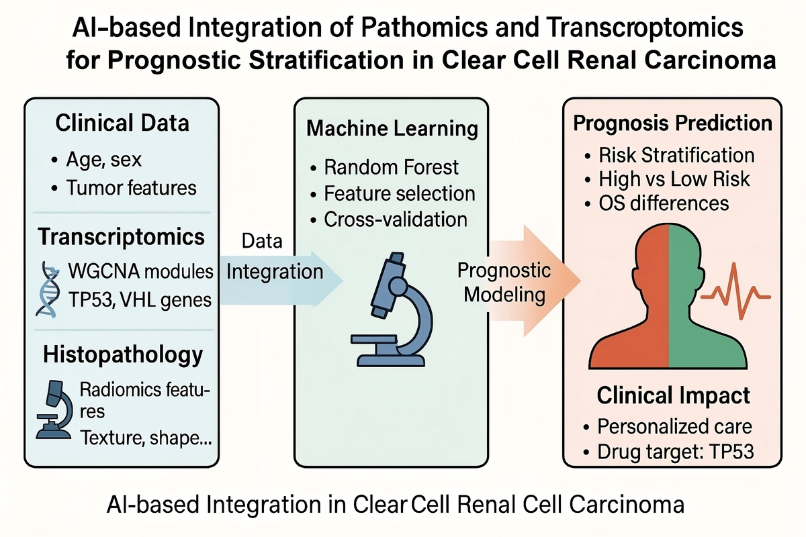

Application of AI-based Machine Learning Integrating Pathomics and Transcriptomics for Diagnosis and Prognostic Prediction in Clear Cell Renal Cell Carcinoma
DOI: 10.5114/aoms/217799
Notes:
Introduction
Clear cell renal cell carcinoma (ccRCC) is the most common and aggressive subtype of renal carcinoma, characterized by high molecular heterogeneity and variable clinical outcomes. Conventional prognostic models often lack the resolution to adequately stratify patient risk, underscoring the need for integrative, data-driven approaches.
Material and methods
We developed a novel diagnostic and prognostic model for ccRCC using an artificial intelligence-based machine learning approach (random forest algorithm) integrating pathomics and transcriptomic data. Whole-slide histopathological images and transcriptomic data were obtained from the TCGA-KIRC cohort. Radiomic features were extracted from histological slides, and gene modules related to tumor progression were identified using Weighted Gene Co-Expression Network Analysis (WGCNA). These modalities, together with clinical variables, were incorporated into a custom machine learning architecture to predict patient survival risk.
Results
The integrative model demonstrated strong predictive performance, effectively stratifying patients into high- and low-risk groups with significant differences in overall survival (p < 0.001). Functional enrichment analysis revealed that prognostic gene modules were associated with immune regulation, angiogenesis, and cell cycle pathways, highlighting their relevance in ccRCC pathogenesis.
Conclusions
This study presents a novel, AI-driven framework that combines multi-omics and imaging data to improve prognostic accuracy in ccRCC. The model offers potential utility in clinical decision-making and personalized treatment strategies, and may serve as a foundation for future precision oncology applications.

