Slide 1
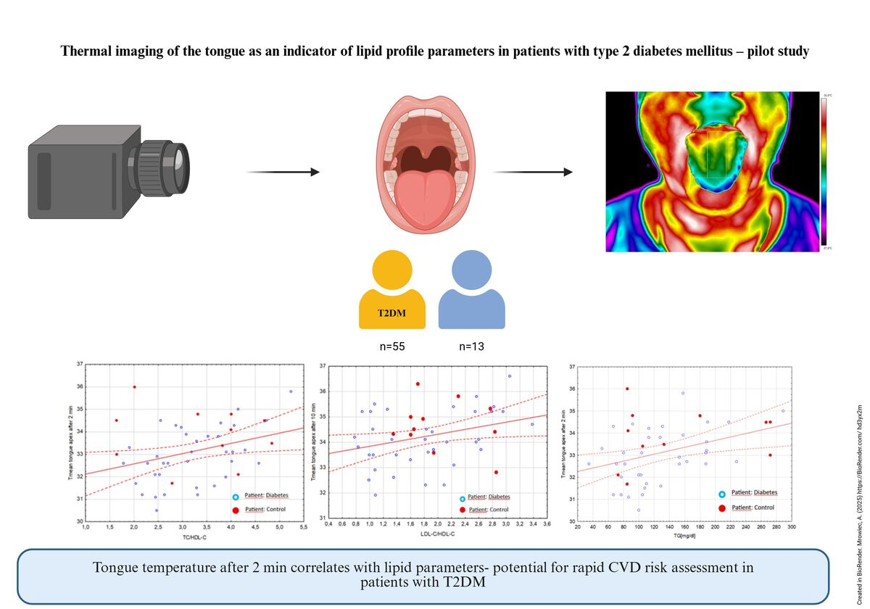

Thermal imaging of the tongue as an indicator of lipid profile parameters in patients with type 2 diabetes mellitus: a pilot study
DOI: 10.5114/aoms/218009
Arch Med Sci 2026;22(3):1338-1346
Notes:
Introduction
Type 2 diabetes mellitus (T2DM) is a metabolic disorder characterized by chronic hyperglycemia and associated carbohydrate, protein, and lipid metabolism disturbances. Poor glycemic control exacerbates the risk of numerous complications, including cardiovascular diseases. Although the oral cavity is among the systems affected by diabetic pathology, its potential to reflect systemic lipid metabolism and cardiovascular risk remains unclear.
Material and methods
This study investigated correlations between biochemical lipid markers and thermal parameters obtained from infrared imaging of the tongue to evaluate cardiovascular risk in T2DM patients. The study cohort comprised 29 individuals with T2DM and 12 healthy controls, following application of inclusion and exclusion criteria. Lipid profile parameters and related ratios were analyzed alongside thermal measurements recorded 2 and 10 min after oral cavity cooling.
Results
Statistically significant positive correlations were identified between tongue surface temperature and lipid-related ratios at 2 min: triglycerides (TG) (r = 0.47, p = 0.002), total cholesterol (TC)/high-density lipoprotein cholesterol (HDL-C) ratio (r = 0.55, p < 0.001), and low-density lipoprotein cholesterol (LDL-C)/HDL-C ratio (r = 0.54, p < 0.001). No significant correlations were observed between glycated hemoglobin (HbA1c), TC, or LDL-C and temperature parameters (p > 0.05).
Conclusions
These findings suggest that thermographic assessment of tongue surface temperature may provide a non-invasive biomarker reflecting lipid metabolism alterations and cardiovascular risk in T2DM patients, supporting its potential utility in early disease diagnosis.

