Slide 1
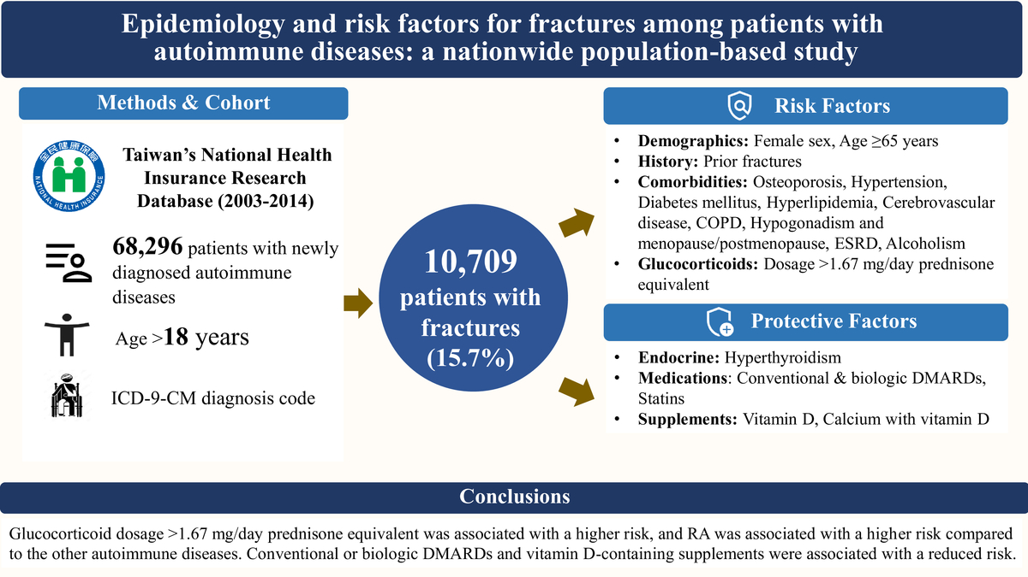

Epidemiology and risk factors for fractures among patients with autoimmune diseases: a nationwide population-based study
DOI: 10.5114/aoms/218060
Notes:
Introduction
Studies concerning the effects of biologic disease-modifying antirheumatic drugs (DMARDs) on fracture risk in patients with autoimmune diseases are limited. This study aimed to identify demographic, disease-specific, and treatment-related risk factors associated with clinical fractures.
Material and methods
Individuals aged >18 years with a newly diagnosed autoimmune disease between 2003 and 2014 were identified from Taiwan’s National Health Insurance Research Database. Multivariate Cox proportional hazards regression was employed to identify risk factors associated with fractures.
Results
Among 68,296 patients (mean age 51.9±15.4 years; 78.4% female), rheumatoid arthritis was the most common autoimmune disease. During a mean follow-up of 5.6±3.5 years, 10,709 (15.7%) patients had fractures. Independent predictors included female sex, age ≥65 years, prior fractures, comorbidities (osteoporosis, hypertension, diabetes mellitus, hyperlipidemia, cerebrovascular disease, chronic obstructive pulmonary disease, hypogonadism and menopause/postmenopause, end-stage renal disease, alcoholism), and glucocorticoid use >1.67 mg/day prednisone equivalent. The fracture risk was lower in patients with systemic lupus erythematosus, systemic sclerosis, vasculitis, pemphigus, Sjögren’s syndrome, polymyositis/dermatomyositis and inflammatory bowel disease compared to those with rheumatoid arthritis. The use of conventional DMARDs, biologic DMARDs (TNF-α and IL-6 inhibitors and selective T-cell co-stimulatory modulator), and vitamin D–containing supplements was independently associated with a reduced fracture risk.
Conclusions
Both general and disease-specific factors contributed to fracture risk. The lower fracture risk among patients treated with DMARDs and vitamin D highlights the benefits of controlling inflammation and optimizing bone health. These findings provide robust, large-scale epidemiologic evidence from a Taiwanese population and underscore the importance of minimizing glucocorticoid exposure.

