Slide 1
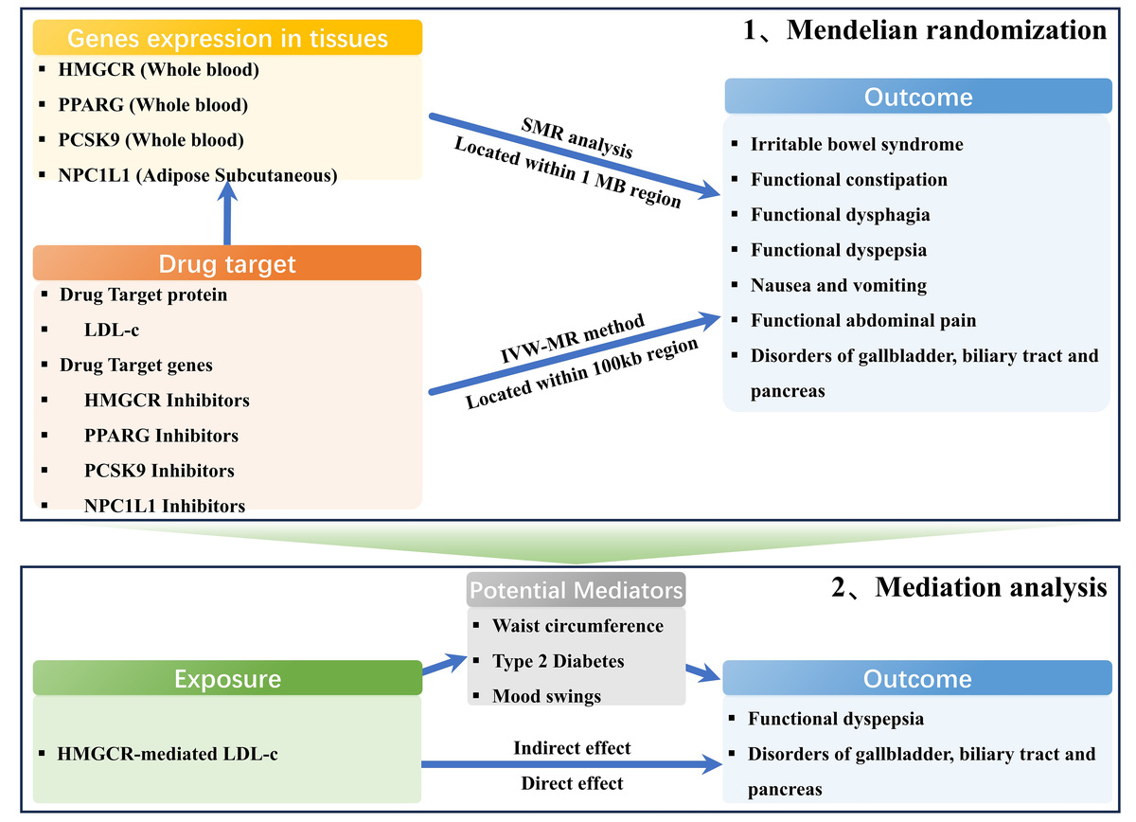

Genetic association of lipid-lowering drugs with functional gastrointestinal disorders: a drug-target Mendelian randomization study
DOI: 10.5114/aoms/218062
Notes:
Introduction
The effect of lipid-lowering drugs on functional gastrointestinal disorders (FGIDs) remains unclear, and the assessment of their relationship is always confounded by extraneous factors.
Material and methods
We detected genetic variants linked to LDL cholesterol (LDL-C) levels in or near the lipid-lowering drug targets (HMGCR, PPARG, PCSK9, and NPC1L1), using data from the Global Lipids Genetics Consortium (GLGC) genome-wide association study. Outcome data for FGIDs including seven disorders were extracted from genome-wide association studies (GWAS) datasets. Inverse-variance-weighted Mendelian randomization (IVW-MR) was conducted to identify the causal effect between four genetically proxied lipid-lowering drugs and FGIDs, and mediation Mendelian randomization (MR) was performed to investigate potential mediators. We employed several sensitivity analyses to validate the robustness of the results.
Results
Seven variants were identified as proxies for LDL-C lowering through HMGCR inhibitors, 3 for PPARG inhibitors, 12 for PCSK9 inhibitors, and 3 for NPC1L1 inhibitors. IVW-MR analysis revealed that genetically proxied HMGCR-mediated LDL-C elevation significantly increased the risk of several gastrointestinal outcomes. These included functional constipation (OR = 1.258, 95% CI: 1.043–1.517), functional dyspepsia (OR = 1.438, 95% CI: 1.014–2.036), nausea and vomiting (OR = 1.536, 95% CI: 1.070–2.207), and disorders of the gallbladder, biliary tract and pancreas (OR = 1.664, 95% CI: 1.392–1.989). Furthermore, mediation analysis identified mood swings as a significant mediator. It accounted for 6.23% of the total effect on functional dyspepsia (OR = 1.023, 95% CI: 1.001–1.058) and for 2.62% of the effect on disorders of the gallbladder, biliary tract, and pancreas (OR = 1.013, 95% CI: 1.001–1.033).
Conclusions
Our study suggested a potential protective effect of HMGCR inhibitors on FGIDs, which may be mediated by a reduced risk of mood swings.

