Slide 1
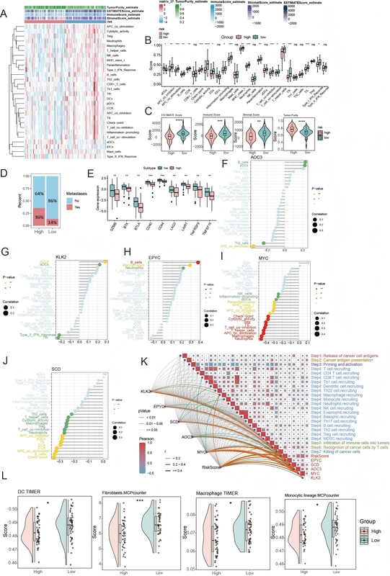

Identification and analysis of immunological characteristics of prognostic feature for osteosarcoma based on costimulatory molecule-related genes
DOI: 10.5114/aoms/218150
Notes:
Introduction
Osteosarcoma (OSA) is a primary malignant bone tumor with poor prognosis. Costimulatory molecule-related genes (CMRGs) are crucial for T cell-mediated antitumor immunity, yet their prognostic and therapeutic value in OSA remains unclear.
Material and methods
Non-negative matrix factorization (NMF) clustering was used to define CMRG-based subtypes. Prognostic signature genes were selected using univariate Cox, LASSO, and multivariate regression analyses. The predictive performance of the model was assessed using ROC curves, calibration plots, and decision curve analysis (DCA). Immune infiltration and immune checkpoint differences were evaluated via ssGSEA. Drug sensitivity was predicted using CellMiner, and gene expression was validated by qRT-PCR in OSA cells.
Results
This study selected five characteristic genes related to the prognosis of OSA and constructed a prognostic model. The evaluation results indicate that the model has favorable predictive performance, with calibration curves and DCA confirming that the predicted survival probabilities aligned with the actual survival probabilities of patients. Furthermore, the response results for immunotherapy revealed that patients with lower risk scores had more favorable immune responses and lower rates of disease metastasis. Notably, DMAPT, Obatoclax, 8-Chloro-adenosine, and Palbociclib showed a significant positive correlation with MYC. Additionally, qRT-PCR results indicated that EPYC, SCD1, and AOC3 were significantly overexpressed in OSA cells.
Conclusions
This study is the first to integrate CMRG-based subtyping, risk modeling, immune profiling, and experimental validation in OSA. The identified biomarkers may guide personalized treatment and improve survival prediction in OSA patients.

