Slide 1
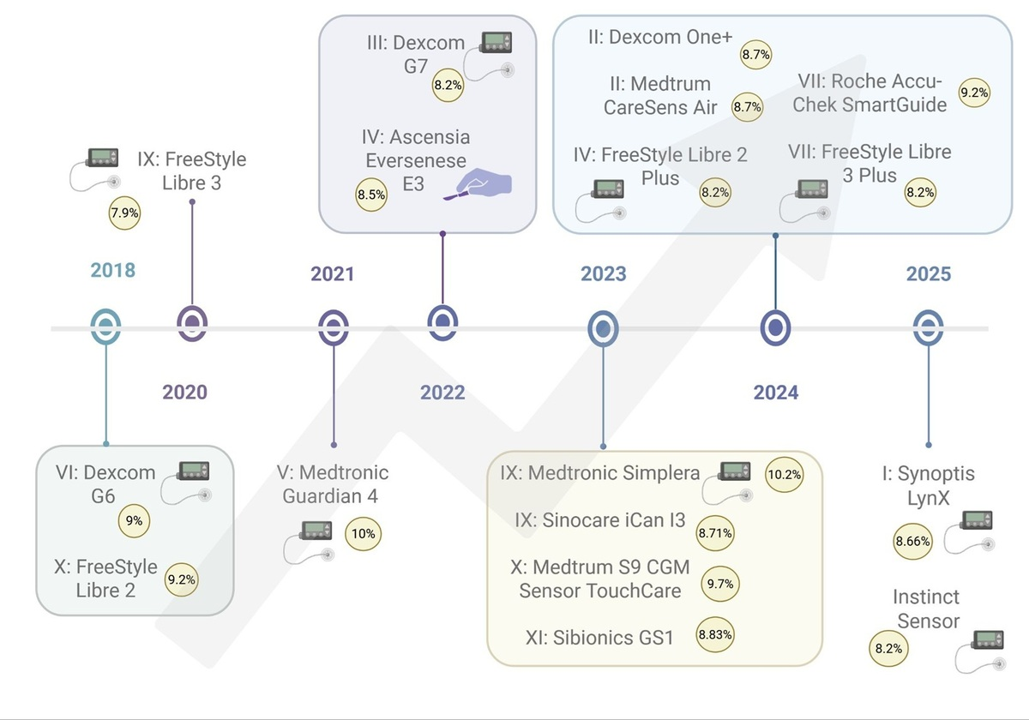

Continuous glucose monitoring (CGM) systems in Poland, Europe, and beyond in 2025: principles, available technologies, and future perspectives
DOI: 10.5114/aoms/218227
Arch Med Sci 2026;22(4):2250-2265
Notes:
In recent years, continuous glucose monitoring (CGM) systems have become increasingly common and more widely available for people with diabetes. A variety of devices appearing on the market, together with their increasing integration with other tools (insulin pumps, watches, and smartphone applications), require medical personnel to have a solid basic knowledge of CGMs, continuous follow-up, updated expertise extending beyond the local market, and a future-oriented perspective. Additionally, low-quality products without proper evaluation, which do not meet the standards established by diabetes societies, become available to patients. To provide an extended background on CGM technology principles, basic knowledge of results presentation, and interpretation according to recommendations, this review presents the most common devices, along with a cost-effectiveness analysis and a critical assessment. Furthermore, future perspectives are discussed, including AI technologies and modern solutions to enhance user comfort.

