Slide 1
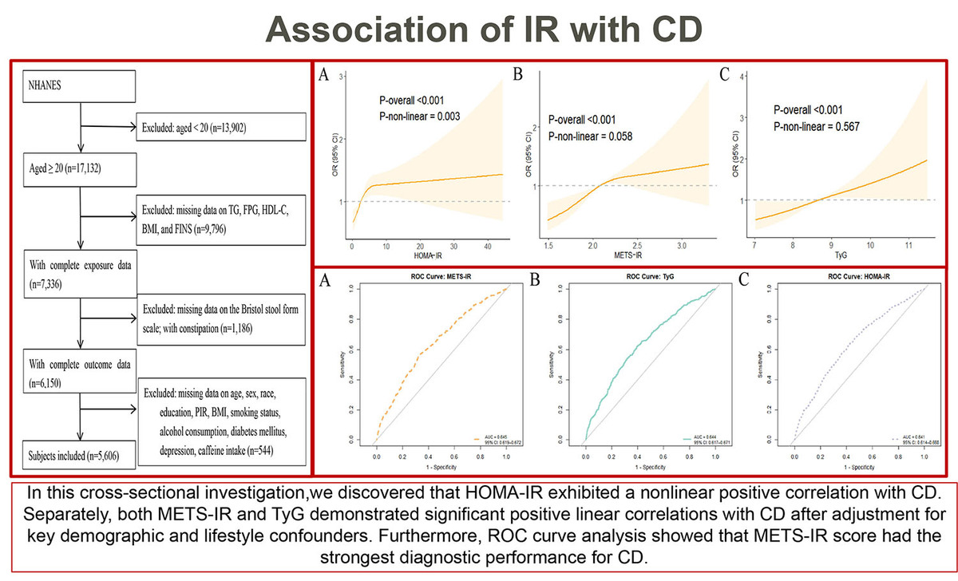

Association of insulin resistance with chronic diarrhea: based on the NHANES database 2005-2010
DOI: 10.5114/aoms/218228
Notes:
Introduction
The evidence regarding the association of insulin resistance (IR) with chronic diarrhea (CD) remains scarce, especially without robust epidemiological support from large-scale population cohorts. Therefore, we aimed to explore the association of IR with CD by a cross-sectional study of data drawn from the National Health and Nutrition Examination Survey(NHANES) from 2005 to 2010.
Material and methods
Multiple logistic regression models combined with subgroup analyses were leveraged to explore the association of IR(triglyceride-glucose[TyG] index, metabolic score for IR [METS-IR] score, and Homeostasis Model Assessment of IR [HOMA-IR] score) with the prevalence of CD. Nonlinear correlations were measured by restricted cubic spline(RCS) curves. Finally, the diagnostic efficacy of these indicators was calculated and examined with the receiver operating characteristic(ROC) curve and area under the curve(AUC).
Results
After full adjustment for covariates(e.g., sex, age, race, education, poverty-to-income ratio (PIR), body mass index (BMI), smoking status), the TyG index(OR: 1.35, 95% CI: 1.12-1.63), METS-IR score(OR: 2.00, 95% CI: 1.31-3.06), and HOMA-IR score (OR: 1.02, 95% CI: 1.00-1.03) showed positive associations with the prevalence of CD. The RCS curve analysis showed a non-linear association between HOMA-IR and CD (P-non-linear=0.003), with an inflection point at 2.423. METS-IR and TyG showed a significant positive linear association with CD(both P-non-linear > 0.05). The ROC curve analysis identified METS-IR score as the optimal diagnostic indicator for CD (AUC=0.645, 95% CI: 0.619-0.672).
Conclusions
The present research discovered a significant positive association of IR with CD among a demographically representative cohort of US adults. Elevated IR scores are significantly associated with the prevalence of CD.

