Slide 1
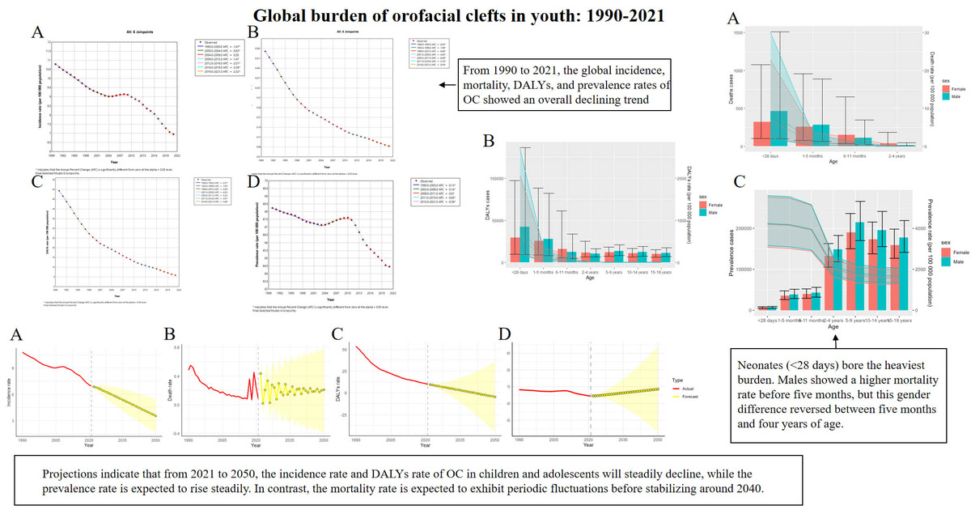

Global, regional, and national incidence, mortality, DALY, and prevalence rates of orofacial clefts in children and adolescents from 1990 to 2021, with predictions to 2050
DOI: 10.5114/aoms/218229
Arch Med Sci 2026;22(1):555-562
Notes:
Introduction
Material and methods
Results
Conclusions

