Slide 1
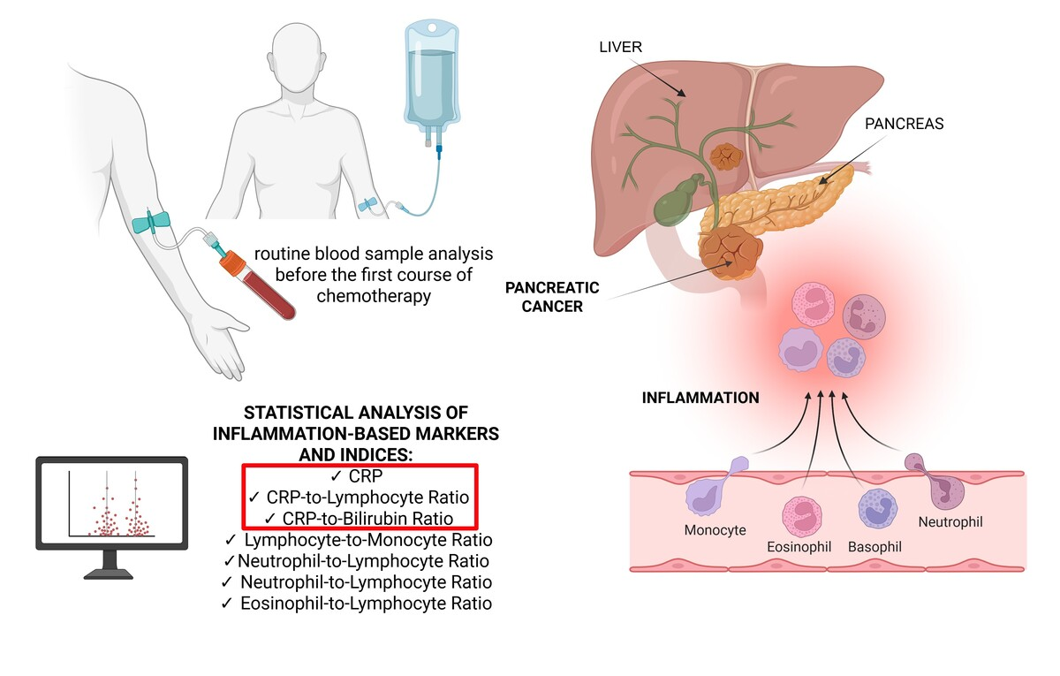

Evaluation of novel prognostic inflammatory markers in pancreatic cancer: a retrospective analysis of a high-volume center
DOI: 10.5114/aoms/218489
Notes:
Introduction
Pancreatic cancer (PC) is one of the leading contributors to global cancer mortality. One direction of research is to evaluate systemic markers of inflammation and their role as predictors of overall survival (OS). The study aimed to assess potential inflammatory markers as prognostic factors for patients with PC.
Material and methods
A retrospective analysis of 310 patients with PC was performed. Baseline laboratory characteristics and inflammatory indices were measured before the first course of chemotherapy. Statistical analyses were performed using appropriate tests.
Results
C-reactive protein (CRP)-to-lymphocyte ratio (CLR) with a cutoff of 10.0 was the strongest OS predictor (AUC = 0.63, HR = 2.29, 95% CI: 1.62–3.22, p < 0.001); however, in further analysis, a value above 10.0 significantly stratified increased mortality risk only in the adjuvant group. CLR was associated with OS in both univariate and multivariate analyses. CRP-to-bilirubin ratio (CBR) with a cutoff of 0.53 (AUC = 0.61, HR = 1.68, 95% CI: 1.23–2.31, p = 0.001) significantly predicted prognosis; however, this association was only observed in the palliative cohort.
Conclusions
This study identified two markers for predicting OS in PC: CBR and CLR. This was the first study to examine the prognostic im-portance of the CBR in patients with PC, emphasizing its potential as a new and practical biomarker that reflects both systemic in-flammation and liver function. However, the CLR demonstrated slightly better performance than the other indices in our cohort. Both CLR and CBR should be viewed as preliminary markers that need further validation through large-scale, prospective, multi-center research.

