Slide 1
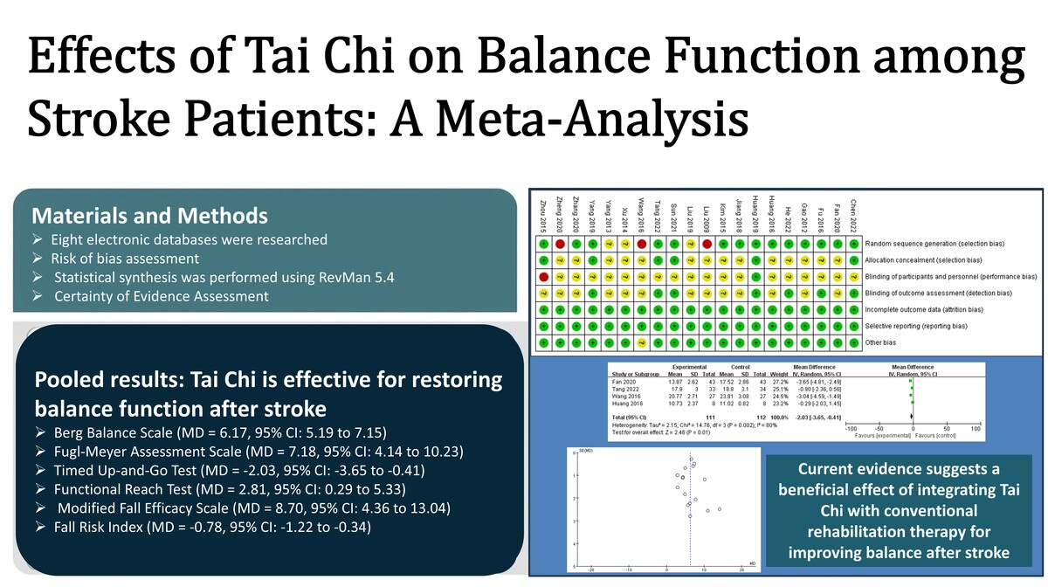

Effects of tai chi on balance function among stroke patients: a meta-analysis
DOI: 10.5114/aoms/218491
Arch Med Sci 2026;22(3):1618-1626
Notes:
Introduction
Impaired balance is a common and debilitating sequela among stroke survivors. Tai chi (TC), a traditional mind-body exercise, has emerged as a promising rehabilitative intervention. This meta-analysis aimed to quantitatively evaluate the effects of TC on balance function in post-stroke patients.
Methods
A systematic literature search was conducted across eight electronic databases (PubMed, Embase, Web of Science, Cochrane Library, CNKI, SinoMed, VIP, and Wanfang Data) from their inception until May 13, 2025, to identify relevant randomized controlled trials (RCTs). Eligible studies compared TC (as an adjunct or standalone therapy) with conventional rehabilitation therapy (CRT) in stroke patients, using balance-related outcomes as endpoints. Methodological quality was assessed using the Cochrane Risk of Bias tool. Statistical synthesis was performed using RevMan software (version 5.4).
Results
Twenty RCTs involving 1296 participants were included. The pooled results demonstrated that, compared to CRT alone, the integration of TC with CRT led to significantly greater improvements across multiple balance measures: the Berg Balance Scale (mean difference [MD] = 6.17, 95% confidence interval [CI]: 5.19 to 7.15), the Fugl-Meyer Assessment scale (MD = 7.18, 95% CI: 4.14 to 10.23), the Timed Up-and-Go test (MD = –2.03, 95% CI: –3.65 to –0.41), the Functional Reach Test (MD = 2.81, 95% CI: 0.29 to 5.33), the Modified Fall Efficacy Scale (MD = 8.70, 95% CI: 4.36 to 13.04), and the Fall Risk Index (MD = –0.78, 95% CI: –1.22 to –0.34).
Conclusions
Current evidence suggests a beneficial effect of integrating TC with CRT for improving balance after stroke. However, due to methodological limitations and the overall quality of the included trials, these findings should be interpreted with caution. More rigorous and well-designed studies are needed before definitive clinical recommendations can be established.

