Slide 1
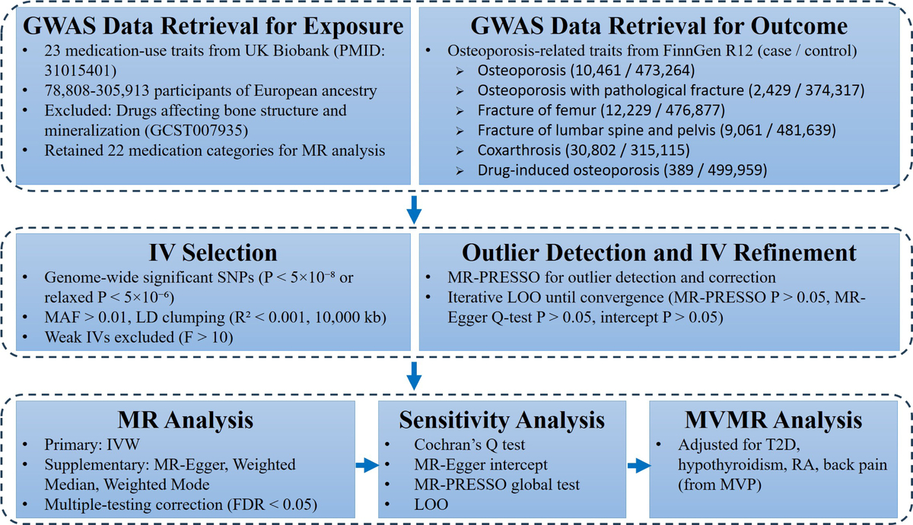

Genetic associations between common medication use and osteoporosis-related outcomes: a Mendelian randomization study
DOI: 10.5114/aoms/218561
Notes:
Introduction
Osteoporosis pathogenesis involves a complex interplay of genetic predisposition and medication exposure. Although long-term medication use contributes to bone fragility, which is distinct from osteomalacia, genetic evidence linking common medication-use traits to osteoporosis remains limited.
Material and methods
Two-sample Mendelian randomization (MR) analyses utilized GWAS data for 22 medication-use traits (UK Biobank) and osteoporosis outcomes (FinnGen R12). Multivariable MR (MVMR) was employed to adjust for confounding by underlying disease indications. Primary estimates were derived using the inverse variance–weighted (IVW) method, supported by comprehensive sensitivity analyses including MR-Egger, weighted median, and MR-PRESSO to evaluate heterogeneity and pleiotropy.
Results
Univariable MR identified seven significant associations: anilide use with higher odds of osteoporosis (OR = 1.25, FDR = 0.0201); immunosuppressant use with higher odds of osteoporosis with pathological fracture (OR = 1.16, FDR = 0.0074) and drug-induced osteoporosis (OR = 1.36, FDR = 0.0168); thyroid preparations with increased odds of osteoporosis (OR = 1.08, FDR = 0.0016), drug-induced osteoporosis, and osteoporosis with pathological fracture; and an inverse association between antidiabetic drug use and osteoporosis (OR = 0.88, FDR = 0.0002). In MVMR, associations for anilide and thyroid preparation use remained significant after adjusting for back pain and hypothyroidism, respectively. However, the antidiabetic association reversed after adjustment for type 2 diabetes, suggesting that the inverse association may reflect the underlying metabolic condition rather than a direct pharmacological effect.
Conclusions
Genetic evidence suggests that anilide and thyroid hormone use may independently increase osteoporosis risk, while the inverse association between antidiabetic drug use and osteoporosis may be confounded by diabetes status. Medication-related osteoporosis should be considered in long-term pharmacologic management.

