Slide 1
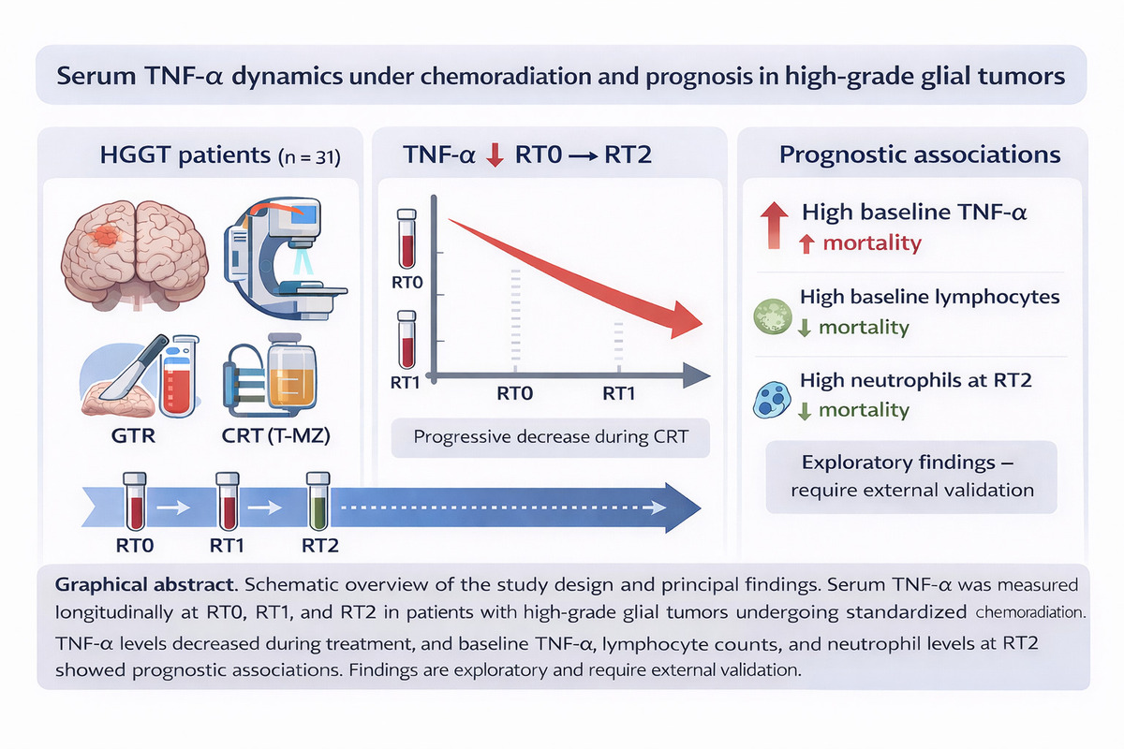

Serum TNF-α dynamics under chemoradiation and prognosis in high-grade glial tumors
DOI: 10.5114/aoms/218562
Notes:
Introduction
Tumor necrosis factor-alpha (TNF-α) is a mediator of cancer-related inflammation and may affect glioma biology. Clinical information on longitudinal TNF-α dynamics during chemoradiation (CRT) and their prognostic relevance in high-grade glial tumors (HGGT) is limited. This study examines serum TNF-α levels in patients with HGGT undergoing CRT.
Material and methods
In this prospective, single-center cohort, 31 adults with HGGT who underwent gross-total resection received standardized IMRT/VMAT with concomitant/adjuvant temozolomide. Serum TNF-α levels were assessed at three predetermined intervals: prior to radiotherapy (RT0), upon completion (RT1), and three months following radiotherapy (RT2). The principal outcome was the variation in TNF-α from RT0 to RT2.
Results
The systemic inflammatory response decreased progressively, with TNF-α levels declining by 33% from RT0 to RT2. Multivariable analysis showed that elevated baseline TNF-α levels were associated with poorer overall survival (hazard ratio [HR] 1.50; 95% CI 1.04–2.16). Patients with elevated baseline lymphocyte counts (HR 0.10; 95% CI 0.03–0.32) and higher neutrophil counts at RT2 (HR 0.35; 95% CI 0.18–0.69) experienced lower mortality rates, within the constraints of sample size and event number.
Conclusions
TNF-α decreases during CRT, and elevated baseline TNF-α levels are associated with increased mortality risk in HGGT. Higher baseline lymphocyte counts and higher neutrophil counts at RT2 are associated with better outcomes, although these findings are hypothesis-generating and require external validation. Any ROC-derived TNF-α cut-off is exploratory and should not be used for clinical decisions without independent validation.

