Slide 1
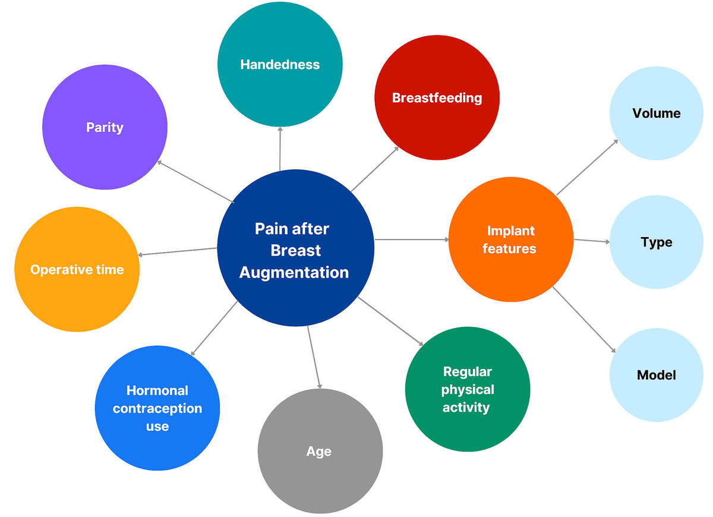

Multifactorial analysis of postoperative pain following silicone breast augmentation: patient- and
procedure-related predictors
DOI: 10.5114/aoms/218626
Notes:
Introduction
Postoperative pain after silicone breast augmentation is influenced by multiple patient- and procedure-related factors, yet limited research has directly evaluated these variables. Understanding predictors of pain may improve analgesic strategies and patient outcomes. The aim of this study was to identify patient- and procedure-related predictors of postoperative pain following elective silicone breast augmentation.
Material and methods
This prospective study enrolled 35 women undergoing elective breast augmentation with silicone gel-filled implants; 28 completed the 14-day protocol. Preoperative questionnaires collected data on age, parity, breastfeeding duration, handedness, hormonal contraception use, satisfaction, and physical activity. Implant characteristics (type, shape, volume) and operative parameters were also analyzed. Patients recorded daily pain for each breast using a 10 cm visual analogue scale (VAS).
Results
Mean VAS pain scores decreased from 79 mm on postoperative day 1 to below 15 mm by day 7, remaining near zero thereafter. Larger implant volume was associated with slightly lower pain on days 1–3. Age negatively correlated with pain on days 13–14. No significant associations were observed with parity, breastfeeding duration, hormonal contraception, physical activity (except day 11), surgical duration, or handedness. Anatomical implants were initially associated with higher early pain scores compared with round implants, but mean pain at day 14 did not differ according to implant type, shape, or height profile.
Conclusions
Postoperative pain following breast augmentation is multifactorial. Most patient- and procedure-related variables, including implant type and model, had a limited long-term impact. Detailed pain monitoring may guide individualized analgesic strategies, optimize perioperative care, and support opioid-sparing approaches.

