Slide 1
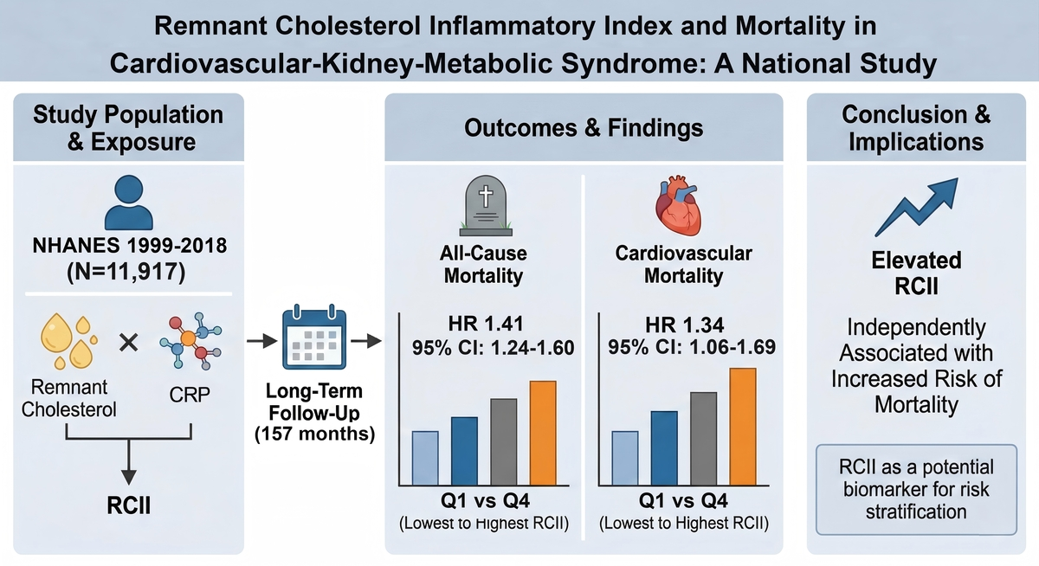

Remnant cholesterol inflammatory index and mortality in cardiovascular-kidney-metabolic syndrome: a national study
DOI: 10.5114/aoms/218809
Arch Med Sci 2026;22(2):672-683
Notes:
Introduction
Cardiovascular-kidney-metabolic (CKM) syndrome reflects the interconnected progression of metabolic dysfunction, kidney impair-ment, and cardiovascular disease. The remnant cholesterol inflammatory index (RCII), integrating remnant cholesterol and C-reactive protein, may capture combined metabolic-inflammatory stress, but its association with mortality in CKM populations is unclear.
Material and methods
Using NHANES 1999-2018, we included adults aged ≥ 18 years with complete CKM staging and RCII measurements. All-cause mor-tality was the primary outcome, and cardiovascular mortality the secondary outcome. Kaplan-Meier analysis, Cox models, restricted cubic splines (RCS), and subgroup analyses were performed to evaluate associations between RCII and mortality.
Results
Among 11,917 CKM participants (median follow-up: 157 months), 2,474 all-cause and 774 cardiovascular deaths occurred. Elevated RCII was associated with increased mortality. In the fully adjusted model, each SD increase in RCII corresponded to a 7% higher risk of all-cause (HR = 1.07, 95% CI: 1.05–1.09) and 8% higher cardiovascular mortality (HR = 1.08, 95% CI: 1.05–1.12) (both p < 0.001). Compared to the lowest RCII quartile (Q1 < 1.61), the highest quartile (Q4 ≥ 13.42) had a 41% higher risk of all-cause (HR = 1.41, 95% CI: 1.24–1.60) and 34% higher cardiovascular mortality (HR = 1.34, 95% CI: 1.06–1.69). RCS analysis revealed significant nonlinear relation-ships, with consistent associations across subgroups and no significant interactions.
Conclusions
Elevated RCII is strongly and consistently associated with increased all-cause and cardiovascular mortality risks among individuals with CKM. Further studies are warranted to validate its incremental predictive value and to explore targeted interventions for popu-lations with high RCII.

