Slide 1
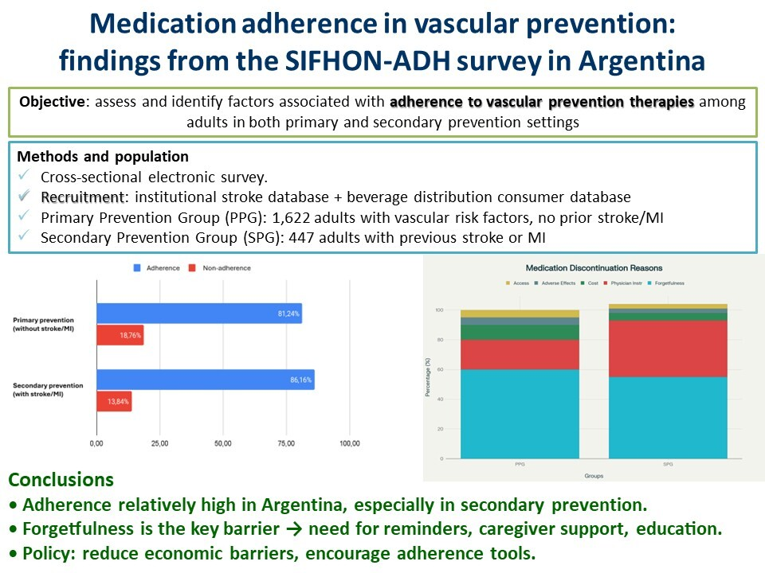

Medication adherence in vascular prevention: findings from the SIFHON-ADH survey in Argentina
DOI: 10.5114/aoms/218810
Arch Med Sci 2026;22(1):531-535
Notes:
Introduction
Material and methods
Results
Conclusions

