Slide 1
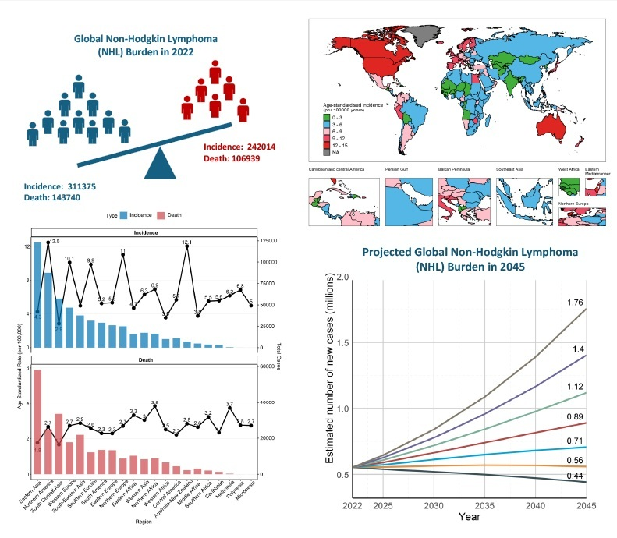

The global landscape of non-Hodgkin lymphoma incidence and mortality in 2022 and projections to 2045
DOI: 10.5114/aoms/218811
Arch Med Sci 2026;22(3):1312-1325
Notes:
Introduction
Updated estimates of the current and future burden of non-Hodgkin lymphoma (NHL) are critical for evaluating global cancer control efforts and addressing disparities in disease impact across regions.
Material and methods
We assessed the 2022 global NHL burden and projected trends to 2045 across 185 countries using population-based cancer registry data from the Cancer Incidence in Five Continents (CI5) database and GLOBOCAN 2022 estimates. Trends in age-standardized incidence rate (ASIR) and age-standardized mortality rate (ASMR) from 1990 to 2017/2020 were analyzed in selected regions to contextualize findings.
Results
In 2022, an estimated 553,389 new NHL cases (ASIR 5.6/100,000) and 250,679 deaths (ASMR 2.4/100,000) occurred globally. The highest case numbers were observed at ages 65–69, with ASIR peaking at 85+ and men consistently showing higher rates. High-HDI regions, such as Northern America (ASIR 12.49) and Australia/New Zealand (ASIR 12.05), reported elevated incidence compared to low-HDI regions like South-Central Asia (ASIR 2.79). East Asia, led by China (14.6% of cases), had the largest case volume. ASIR strongly correlated with HDI (r = 0.655, p = 3.21E-22), while ASMR showed no significant correlation (r = 0.002, p = 0.982). By 2045, NHL cases are projected to increase to 889,841 and deaths to 433,254, with low-HDI regions experiencing the steepest rises.
Conclusions
Our findings reveal pronounced global disparities in NHL burden, with high-HDI regions benefiting from treatment advances, while low-HDI areas face escalating challenges by 2045. Addressing aging-driven incidence, expanding diagnostic capacity in resource-limited settings, and strengthening prevention efforts are imperative to tackle these inequities and curb the projected burden.

