Slide 1
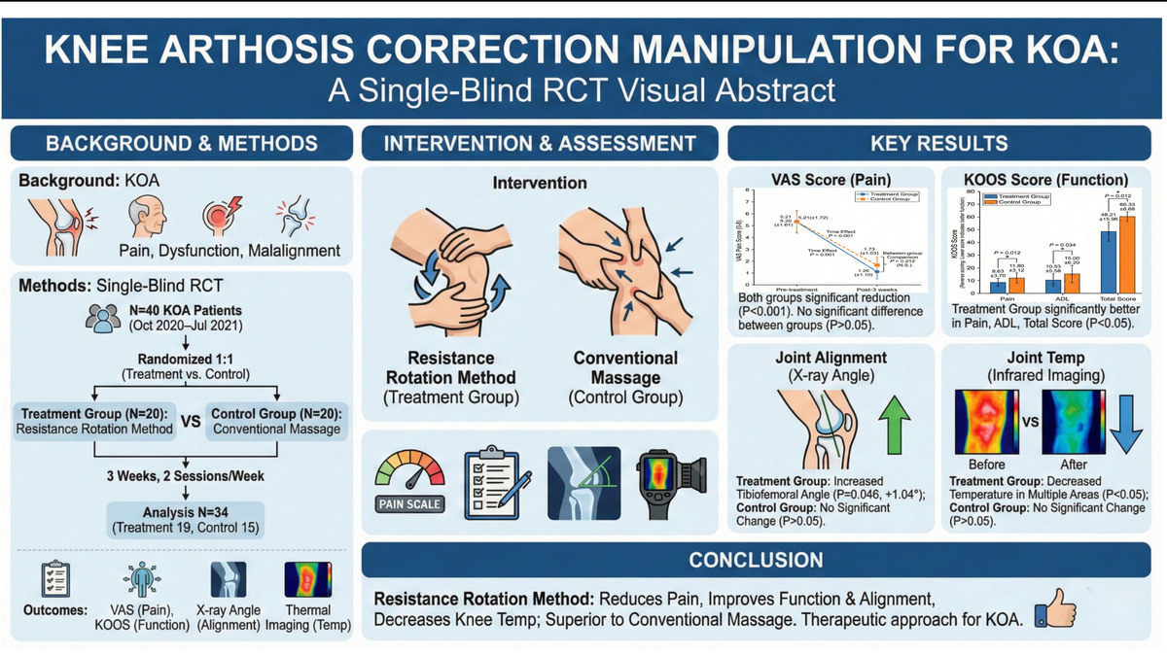

Effect of resistance rotational correction manipulation for the knee joint on joint force line and joint temperature in patients with knee osteoarthritis: A randomized controlled trial.
DOI: 10.5114/aoms/218943
Notes:
Introduction
Knee osteoarthritis (KOA) is a common chronic degenerative disease in middle-aged and elderly people, characterized by joint pain, functional impairment, and abnormal joint alignment.
Material and methods
A single-blind, randomized controlled trial was conducted, selecting 40 patients with knee osteoarthritis (KOA) who visited the outpatient department of the Affiliated Hospital of Shandong University of Traditional Chinese Medicine from October 2020 to July 2021.
Results
Ultimately, 34 patients (19 in the treatment group and 15 in the control group) completed the study (6 dropped out, dropout rate 15%). After treatment, VAS scores in both groups were significantly lower than before treatment (treatment group: 5.21±1.72 vs 1.26±1.10, P<0.001; control group: 5.20±1.61 vs 1.73±1.03, P<0.001), but the difference between the groups was not statistically significant (MD = -0.47, 95% CI: -1.22 to 0.28, P=0.212). Both groups showed significant improvements in KOOS scores across dimensions such as pain, symptoms, and activities of daily living compared to pre-treatment levels (P<0.05). Furthermore, the treatment group demonstrated superior scores compared to the control group in pain (8.63±3.70 vs 11.80±3.12, MD = -3.17, 95% CI: -5.60 to -0.74, P=0.012), activities of daily living (10.53±5.58 vs 18.00±8.20, MD = -7.47, 95% CI: -13.00 to -1.95, P=0.010).
Conclusions
Knee joint resistance rotation therapy can effectively reduce pain, improve joint function, improve joint alignment, and lower knee joint temperature in patients with knee arthritis (KOA). Its efficacy is superior to conventional massage therapy, providing new ideas and methods for the clinical treatment of KOA.

