Slide 1
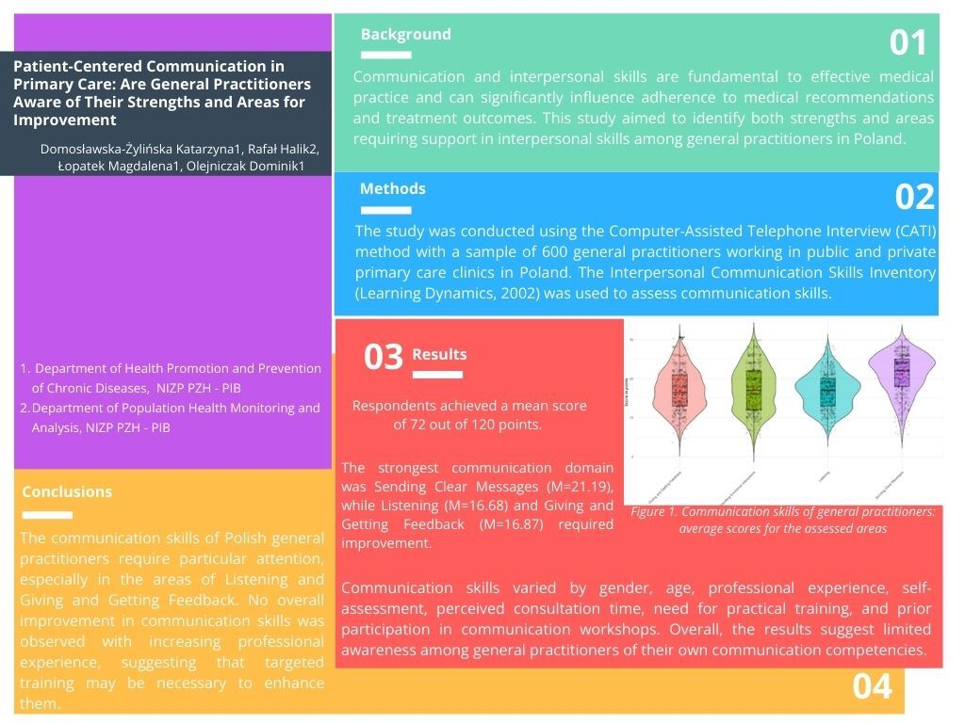

Patient-centred communication in primary care: are general practitioners aware of their strengths and areas for improvement?
DOI: 10.5114/aoms/218944
Arch Med Sci 2026;22(2):642-651
Notes:
Introduction
Communication and interpersonal skills are fundamental to effective medical practice and can significantly influence adherence to medical recommendations and treatment outcomes. This study aimed to identify both strengths and areas requiring support in interpersonal skills among general practitioners in Poland.
Material and methods
The study was conducted using the computer-assisted telephone interview (CATI) method with a sample of 600 general practitioners working in public and private primary care clinics in Poland. The Interpersonal Communication Skills Inventory (Learning Dynamics, 2002) was used to assess communication skills.
Results
The average score obtained by respondents was 72 out of a possible 120 points. Analysis of specific communication skill domains indicated that the strongest area was Sending Clear Messages (M = 21.19, SD = 5.01). However, Listening (M = 16.68, SD = 4.45) and Giving and Receiving Feedback (M = 16.87, SD = 5.12) were identified as areas requiring improvement. Variations in communication skill levels were associated with factors such as gender, age, years of professional experience, self-assessed communication skills, perceived adequacy of consultation time, perceived need for practical communication training and prior participation in doctor-patient communication workshops. The findings indicate that the surveyed general practitioners may have an insufficient awareness of their own communication skills.
Conclusions
The communication skills of Polish general practitioners require particular attention, especially in the areas of Listening and Giving and Receiving Feedback. No overall improvement in communication skills was observed with increasing professional experience, suggesting that targeted training may be necessary to enhance them.

