Slide 1
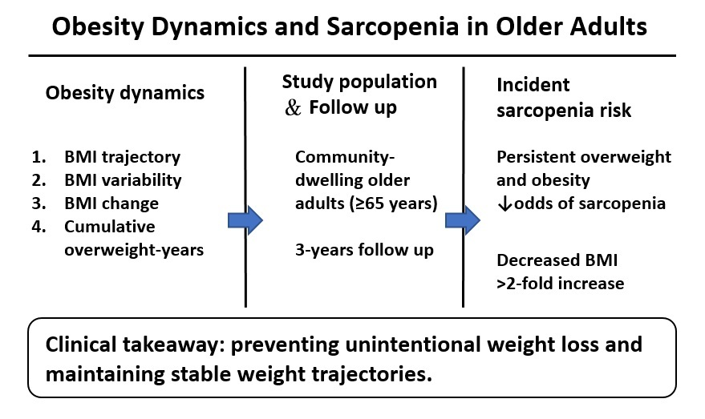

Long-Term Weight Patterns and Risk of Sarcopenia in Community-Dwelling Older Adults: A Three-Year Cohort Study
DOI: 10.5114/aoms/219139
Notes:
Introduction
Static body mass index (BMI) measurements fail to capture the clinical implications of body weight fluctuations. Therefore, this study investigated the association between multi-dimensional obesity dynamics and incident sarcopenia in community-dwelling older adults.
Material and methods
The analytic cohort included 1,091 participants. Of these, 478 completed all assessments at the 3-year follow-up and were analyzed. Despite this attrition, baseline characteristics remained comparable between completers and those lost to follow-up. Obesity dynamics were assessed using BMI trajectories, variability, 3-year change, and cumulative overweight-years. Sarcopenia was defined according to the 2019 Asian Working Group for Sarcopenia (AWGS) criteria. We applied logistic regression models, adjusting for demographics, comorbidities, lifestyle factors, and physical activity.
Results
Persistent overweight (odds ratio (OR) = 0.31, 95% confidence interval (CI): 0.14-0.67, p = 0.003) and persistent obesity (OR = 0.21, 95% CI: 0.06-0.74, p = 0.016) were associated with significantly lower odds of developing sarcopenia compared with a stable normal BMI, whereas decreased BMI was linked to more than a twofold higher risk (OR = 2.70, 95% CI: 1.17-6.23, p = 0.020). Our analysis of sarcopenia components demonstrated that maintaining an overweight or obese status, along with higher cumulative overweight-years, correlated with a reduced risk of developing low muscle mass (all p < 0.001).
Conclusions
These findings emphasize the importance of monitoring weight trajectories to prevent unintentional weight loss rather than promoting obesity in later life. Clinicians should prioritize maintaining weight stability to mitigate sarcopenia risk.

