Slide 1
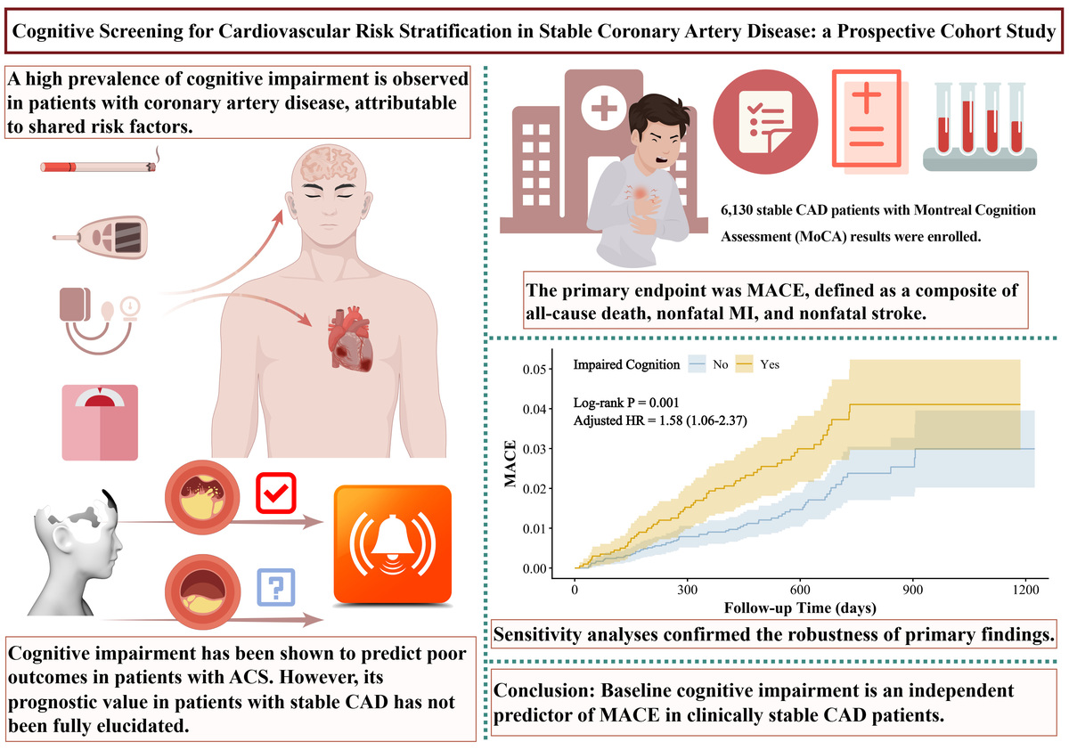

Cognitive screening for cardiovascular risk stratification in stable coronary artery disease: a prospective cohort study
DOI: 10.5114/aoms/219383
Arch Med Sci 2026;22(3):1359-1371
Notes:
Introduction
While cognitive impairment is prevalent in patients with coronary artery disease (CAD), its prognostic significance in stable CAD patients remains unclear.
Material and methods
In this prospective cohort study of 6,130 stable CAD patients, baseline cognitive function was assessed using Montreal Cognitive Assessment (MoCA). The primary outcome was major adverse cardiovascular events (MACE), including all-cause death, nonfatal myocardial infarction, and nonfatal stroke. Unplanned revascularization was specified as a secondary outcome. Kaplan-Meier survival analysis and Cox regression were used to assess the prognostic impact of cognitive impairment. The robustness of the findings was tested via subgroup analyses and sensitivity analyses.
Results
Over a median follow-up of 549 days, 123 (2.0%) patients experienced a MACE, and 315 (5.1%) underwent unplanned revascularization. Patients in the MACE group had significantly lower baseline cognitive function. Worse cognitive function was observed in older adults, females, individuals with lower educational attainment, and those with cardiometabolic risk factors. Patients with cognitive impairment had a significantly higher incidence of MACE (log-rank p = 0.001). In contrast, no significant difference was observed in the incidence of unplanned revascularization (log-rank p = 0.791). After multivariable adjustment, cognitive impairment remained an independent predictor of MACE (HR = 1.58, 95% CI: 1.06–2.37, p = 0.026). Sensitivity analyses confirmed the robustness of primary findings. In subgroup analyses, cognitive impairment showed a consistent trend toward increased MACE risk across all strata, with the notable exception of the subgroup with low-density lipoprotein cholesterol < 1.8 mmol/l.
Conclusions
Baseline cognitive impairment is an independent predictor of MACE in stable CAD patients.

