Slide 1
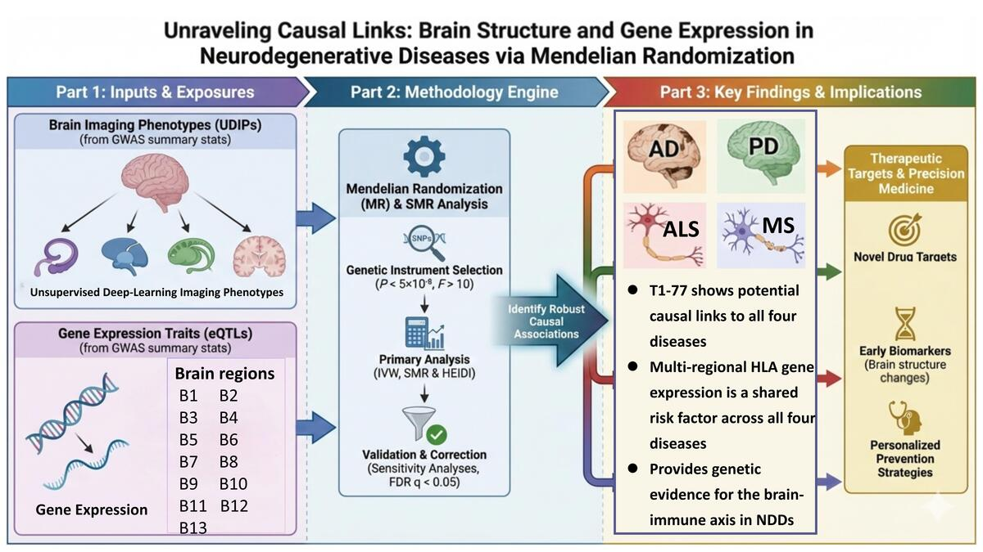

Genetically inferred effects of brain structure and gene expression on neurodegenerative diseases: a Mendelian randomization study
DOI: 10.5114/aoms/219499
Arch Med Sci 2026;22(3):1663-1677
Notes:
Introduction
Against the backdrop of accelerating population aging, the risk of neurodegenerative diseases (NDDs) has risen significantly. While brain structure plays a critical role in NDDs, the interplay between them remains unclear. This study employed Mendelian randomization (MR) to investigate potential causal relationships between brain structure, region-specific gene expression, and four NDDs – Alzheimer’s disease (AD), Parkinson’s disease (PD), amyotrophic lateral sclerosis (ALS), and multiple sclerosis (MS) – providing new directions and genetically informed hypotheses for disease research.
Material and methods
MR analyses were conducted using inverse-variance weighted (IVW), MR-Egger, weighted median, weighted mode, and Wald ratio methods. Summary-data-based MR (SMR) was applied to identify brain genes influencing NDDs. We calculated F-statistics, 95% confidence intervals (CIs), odds ratios, and p-values. Sensitivity analyses included the heterogeneity I² statistic, Cochran’s Q test, Egger intercept test, MR-PRESSO, and leave-one-out validation.
Results
Data from 512 unsupervised deep-learning imaging phenotypes (UDIPs) were analyzed. Thirty-four UDIPs showed associations consistent with a potential causal role in AD, 56 in PD, 22 in ALS, and 92 in MS. After false discovery rate (FDR) correction, 4 remained significant for AD and PD, 3 for ALS, and 28 for MS (p < 0.05). Brain regions (excluding the cervical spinal cord C-1) exhibited shared causal genetic features across all four NDDs, primarily involving HLA-class genes.
Conclusions
This study provides genetic evidence suggestive of potential causal associations between UDIPs, brain gene expression, and NDDs. These findings offer genetically predicted evidence that may generate hypotheses and inform future mechanistic research into NDD pathogenesis.

