Slide 1
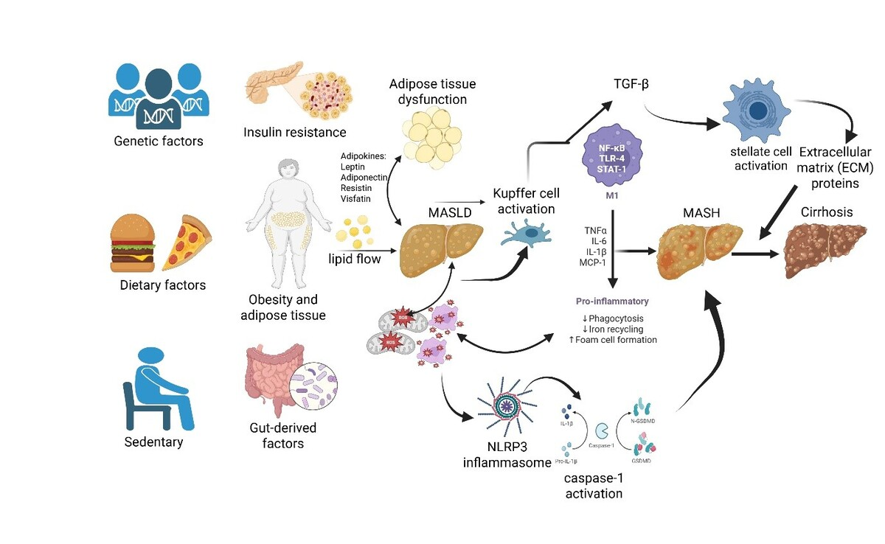

Biomarkers for early identification of metabolic dysfunction-associated steatotic liver disease (MASLD): a narrative review
DOI: 10.5114/aoms/219846
Arch Med Sci 2026;22(2):602-641
Notes:
Metabolic dysfunction-associated steatotic liver disease (MASLD) has a globally increasing prevalence. Oxidative stress and inflammation, as interdependent processes, play pivotal roles in the pathogenesis of MASLD. Moreover, heritability has a significant impact on MASLD. Hence, to fully understand the nature of complex and multifactorial diseases such as MASLD, it is important to consider the role of genetic and epigenetic factors as essential aspects of a broader context that includes clinical and environmental influences and their interactions when multiple metabolic pathways are involved. While traditional biomarkers may be insufficient in the early stages of this process, new-generation biomarkers and multi-omic approaches hold the potential to contribute to the improvement of disease diagnosis and prognosis. This review article aims to systematically examine oxidative stress and inflammation biomarkers, as well as genetic and epigenetic factors in MASLD, highlighting current diagnostic advances and future perspectives in the field.

