Slide 1
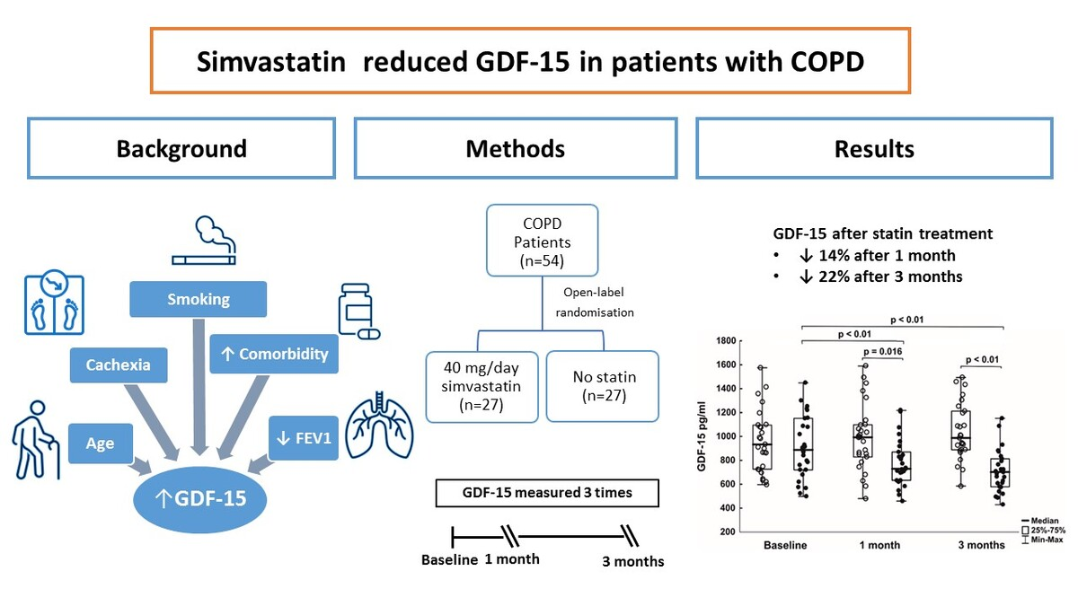

Simvastatin reduces growth differentiation factor-15 in patients with chronic obstructive pulmonary disease
DOI: 10.5114/aoms/219847
Arch Med Sci 2026;22(2):848-856
Notes:
Introduction
In patients with chronic obstructive pulmonary disease (COPD), statins may improve lung function and reduce exacerbations. In COPD, growth differentiation factor-15 (GDF-15) has been shown to correlate with increasing age, current smoking, and greater comorbidity, and to predict disease outcomes; however, the effect of statins on GDF-15 is not known.
Material and methods
This study was designed as a post-hoc analysis of GDF-15 levels in serum samples obtained from 54 patients with COPD (49 men; 90.7%), who had a 1-second forced expiratory volume (FEV1) to forced vital capacity (FVC) ratio < 0.7. Patients assigned (1 : 1) to receive simvastatin (40 mg/day) or to remain without such treatment were followed for 3 months. Lung function and laboratory parameters, including C-reactive protein, tumor necrosis factor-a (TNF-a), interleukin-6, and plasminogen activator inhibitor type 1 (PAI-1), were also assessed.
Results
Baseline GDF-15 concentrations (median: 907.5 pg/ml, interquartile range: 720–1095 pg/ml) correlated negatively with FEV1 (r = –0.38, p < 0.01) and positively with age (r = 0.32, p = 0.017), TNF-a (r = 0.31, p = 0.031), and PAI-1 (r = 0.40, p < 0.01), but not with lipid profile or other variables. Simvastatin reduced GDF-15 by 23% at 3 months compared to baseline (p < 0.01), independently of changes in lipid variables or inflammatory markers. At both 1 and 3 months, GDF-15 levels in the statin-treated group were 14% and 22% lower compared to the untreated control group (both p < 0.05).
Conclusions
Our study suggests that statin treatment can reduce circulating GDF-15 levels associated with COPD severity, which may be an additional benefit of such treatment beyond lipid-lowering or anti-inflammatory effects.

