Slide 1
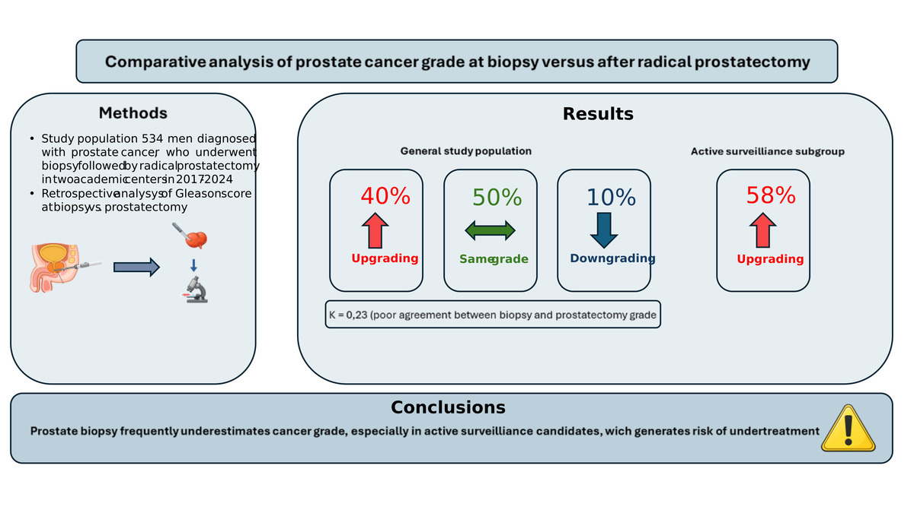

Comparative analysis of prostate cancer grade at biopsy and radical prostatectomy: a retrospective observational study
DOI: 10.5114/aoms/219848
Notes:
Introduction
Accurate Gleason grading is essential for optimal treatment selection in prostate cancer, particularly in patients eligible for active surveillance (AS). This study aimed to assess the rate of Gleason score upgrading after radical prostatectomy and its clinical implications in a large Polish cohort of patients with prostate cancer.
Material and methods
The data of 534 men with localized prostate cancer treated with radical prostatectomy at two academic centers (2017–2024) were retrospectively analyzed. Gleason scores of preoperative biopsy specimens were compared with those of whole mount prostatectomy specimens. Statistical analyses included Wilcoxon signed rank, X<sup>2</sup>, Kendall’s t, and Cohen’s k tests.
Results
Overall, Gleason scores were upgraded in 40% of the patients, downgraded in 10%, and concordant in 50%. Among the patients meeting AS criteria at diagnosis (clinical stage ≤ T2a, PSA level < 10 ng/ml, Gleason score 3 + 3 (ISUP 1), PSA density < 0.2 ng/ml/ml, and involvement of ≤ 2 cores), upgrading occurred in 58% and downgrading in 0%. International Society of Urological Pathology grading showed a similar pattern (upgrading in 41%, downgrading in 16%). Agreement between biopsy and prostatectomy grading was low (k ≈0.23).
Conclusions
A high Gleason upgrading rate, especially among patients who met active surveillance eligibility criteria but ultimately underwent radical prostatectomy, indicates potential underestimation of biopsy grading in routine practice. Incorporating multiparametric magnetic resonance imaging with targeted biopsy and considering centralized pathology review may improve selection for AS and reduce undertreatment of clinically significant disease. These findings underscore the limitations of biopsy-based grading in routine clinical practice and highlight the need for cautious selection of patients for active surveillance.

