Slide 1
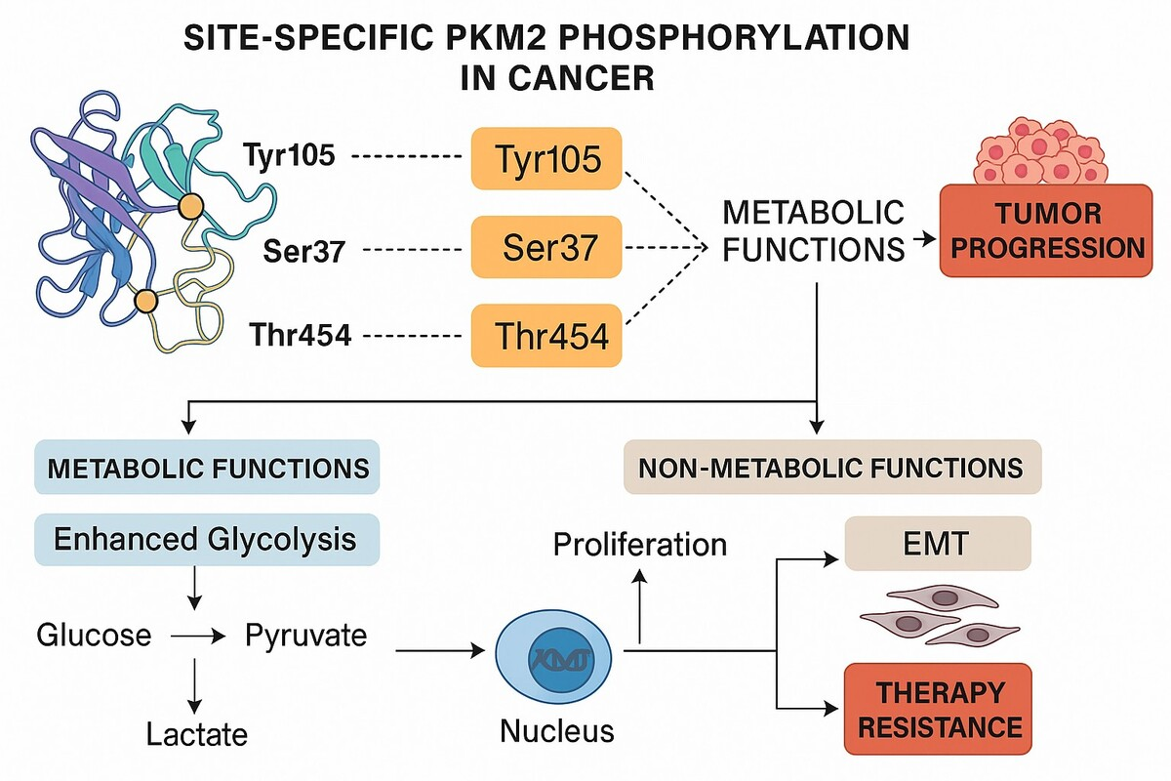

Site-specific PKM2 phosphorylation in Cancer: A systematic review of its role in metabolic plasticity and precision therapy
DOI: 10.5114/aoms/219970
Notes:
Pyruvate Kinase M2 (PKM2), a central glycolytic enzyme, plays a key role in tumour metabolism and growth. Its activity is regulated via site-specific phosphorylation at Tyr105, Ser37, and Thr454, affecting metabolic plasticity, tumour progression, and therapy resistance. This systematic review consolidates evidence on PKM2 phosphorylation in cancer, its metabolic and signalling roles, and potential as a biomarker and therapeutic target in precision oncology. A systematic search of PubMed, Scopus, and EMBASE was conducted per PRISMA 2020 guidelines. Studies examining site-specific PKM2 phosphorylation and its functional or clinical relevance in cancer were included. Data extraction focused on phosphorylation sites, signalling pathways, metabolic and tumour effects, and therapeutic applications. Fifty-eight studies met inclusion. Tyr105, Ser37, and Thr454 influenced PKM2 activity, localization, and oncogenic interactions, enhancing glycolysis, tumour plasticity, growth, and therapy resistance. Site-specific PKM2 phosphorylation regulates metabolism and tumour behaviour, highlighting its value as a biomarker and therapeutic target.

